Slide 1








Tracking Progress of the Mitigation Commitments of Nationally Determined Contributions (NDCs)
Dominic Sheldon
Senior Consultant – Climate Action Planning and Transparency
Ricardo Energy and Environment
LEAP tool

Slide 2
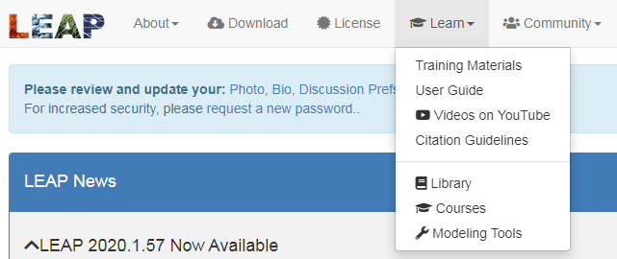

LEAP resources available
Low Emissions Analysis Platform

Slide 3
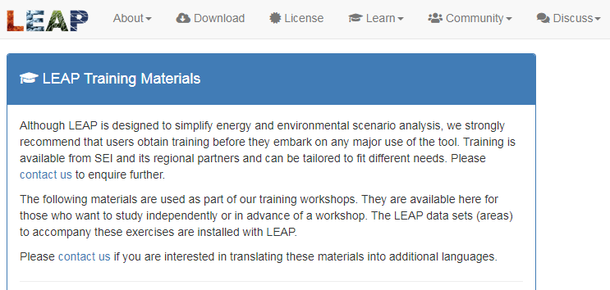
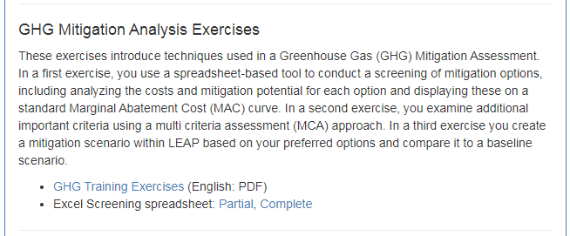
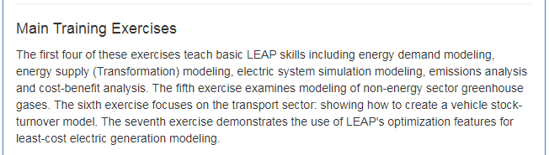
LEAP resources available: Training materials

Slide 4
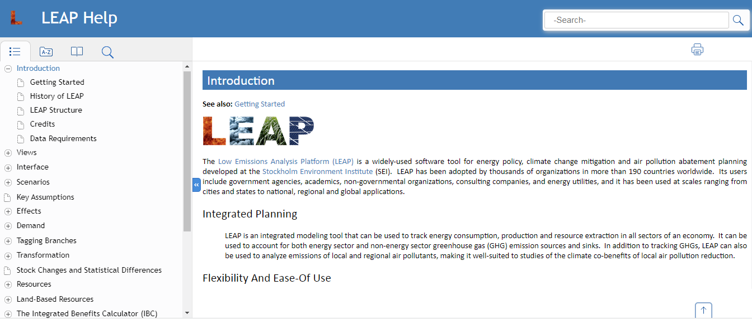
LEAP resources available: User guide

Slide 5
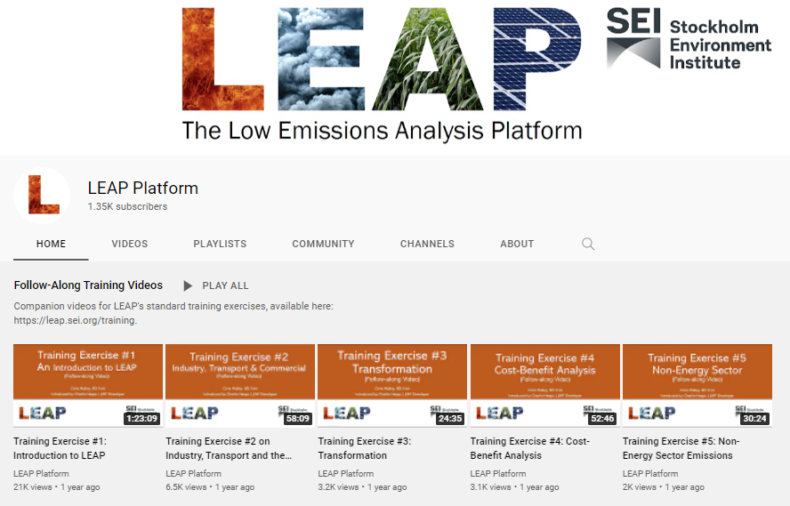
LEAP resources available: YouTube training videos

Slide 6

Introduction to LEAP
In order to develop the scenarios described in the previous section, a pre-existing model, the Low Emissions Analysis Platform (LEAP), was used. LEAP is an integrated, scenario-based modelling tool that can be used to track energy consumption, production and resource extraction in all sectors of an economy. The benefits of using LEAP in this project are:
  It is a model that is familiar to key stakeholders around the world and has been used for previous modelling exercises, so will allow for greater comparability with previous GHG scenarios.
  The LEAP model has been used for NDCs and LTSs
  The model is relatively simple to use.
  The model is free for developing countries to use
  Its low initial data requirements are well suited to a country like Uganda where accessing robust data has been, and will continue to be, a challenge.
  It presents outputs in a transparent and intuitive way.

Slide 7
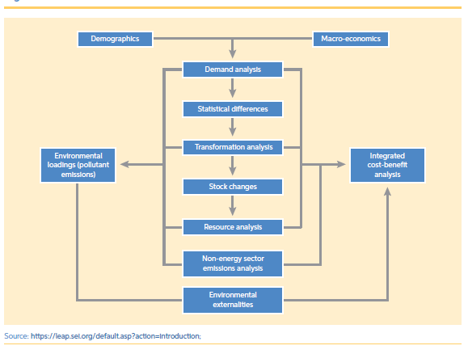
LEAP can be intimidating

Slide 8


Basic structure of LEAP model: The Tree and its branches
Households
Demand
Transport

Slide 9

Basic structure of LEAP model: The Tree and its branches
Uganda TraCS
Households
Urban
Demand
Transport
Rural

Slide 10
Basic structure of LEAP model: The Tree and its branches
Uganda TraCS
Households
Urban
Electrified
Demand
Non-electrified
Transport
Rural
Non-electrified

Slide 11
Basic structure of LEAP model: The Tree and its branches
Uganda TraCS
Households
Urban
Electrified
Lighting
Demand
Non-electrified
Cooking
Transport
Refrigeration
Rural
Non-electrified
Lighting
Cooking

Slide 12

Basic structure of LEAP model: The Tree and its branches
Uganda TraCS
Electricity
Households
Urban
Electrified
Lighting
Kerosene
Demand
Non-electrified
Cooking
Transport
Refrigeration
Rural
Non-electrified
Lighting
Kerosene
Cooking

Slide 13

Basic structure of LEAP model: The Tree and its branches
Uganda TraCS
Electricity
Households
Urban
Electrified
Lighting
Diesel
Demand
Non-electrified
Cooking
Transport
Refrigeration
Electricity
Rural
Non-electrified
Lighting
Diesel
Cooking

Slide 14

Basic structure of LEAP model: The Tree and its branches
Uganda TraCS
Electricity
Households
Urban
Electrified
Lighting
Kerosene
Demand
Non-electrified
Cooking
Emissions
Transport
Refrigeration
Rural
Non-electrified
Lighting
Kerosene
Emissions
Cooking

Slide 15
Basic structure of LEAP model: The Tree and its branches
Uganda TraCS
NMT
Road
Motorcycles
Passenger
Aviation
Petrol
Emissions
Demand
Cars
Freight
Rail
Diesel
Emissions
Small bus
Waterborne
M-L bus

Slide 16
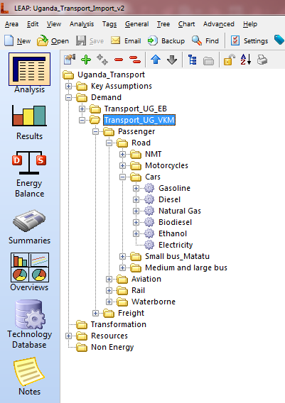
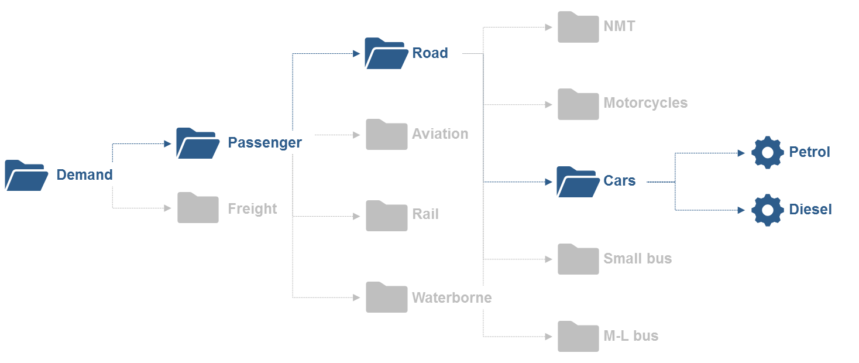
Basic structure of LEAP model: The Tree and its branches

Slide 17

Basic structure of LEAP model: The Tree and its branches
Households
Cooking
Natural gas
Emissions
Demand
Cars
Gasoline
Emissions
Transport
Passenger
Road
Buses
Diesel
Emissions

Slide 18
Basic structure of LEAP model: The Tree and its branches
Target: 40% energy efficiency savings by 2035
Households
Cooking
Natural gas
Emissions
Demand
Cars
Gasoline
Emissions
Transport
Passenger
Road
Buses
Diesel
Emissions
Target: 30% modal shift from cars to buses

Slide 19
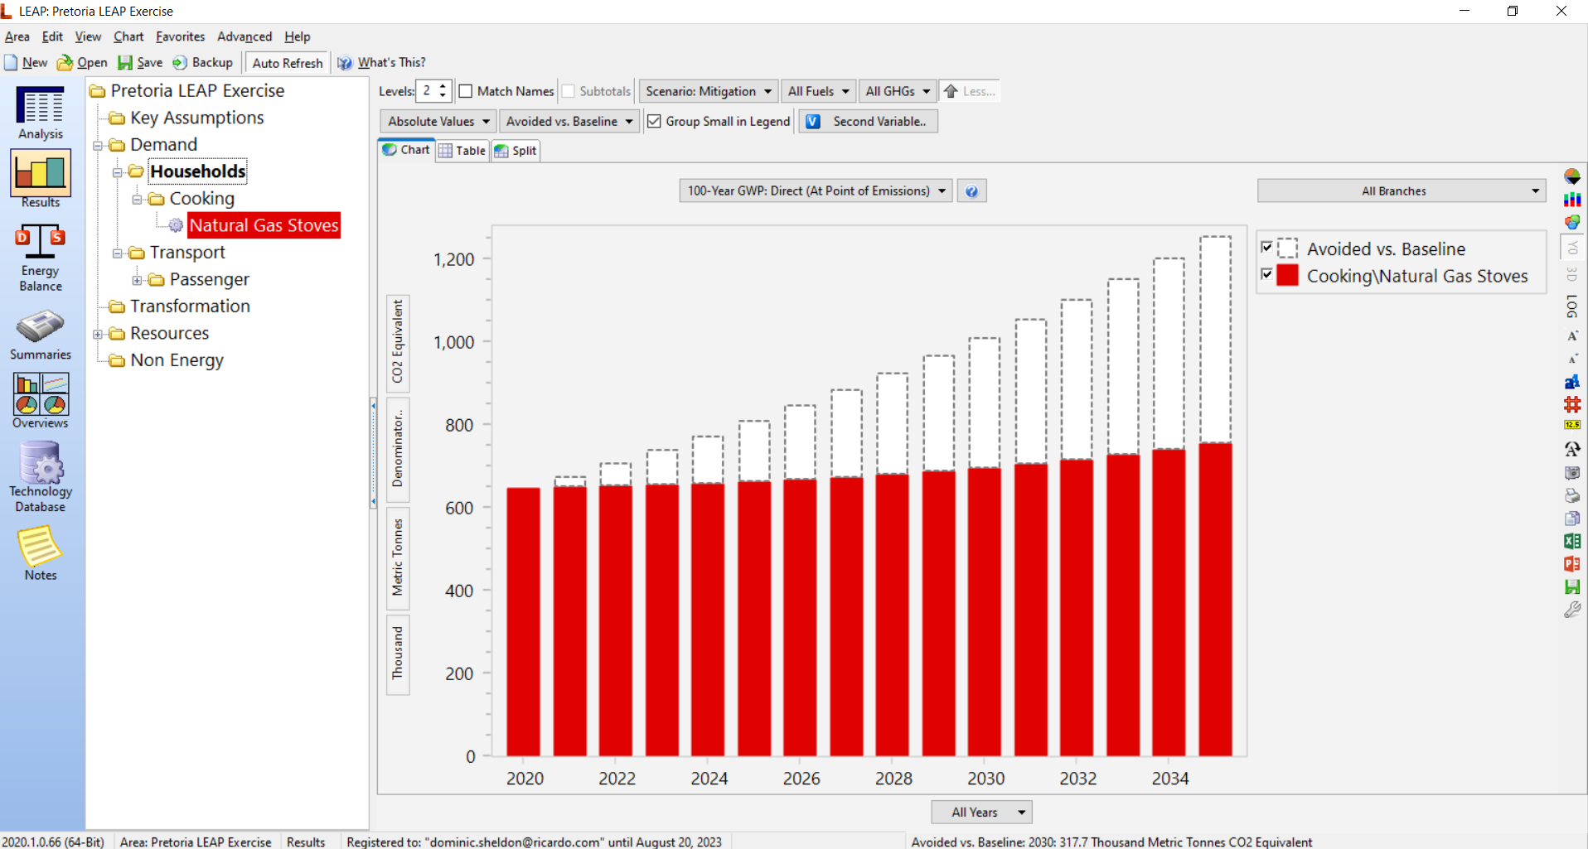

Slide 20
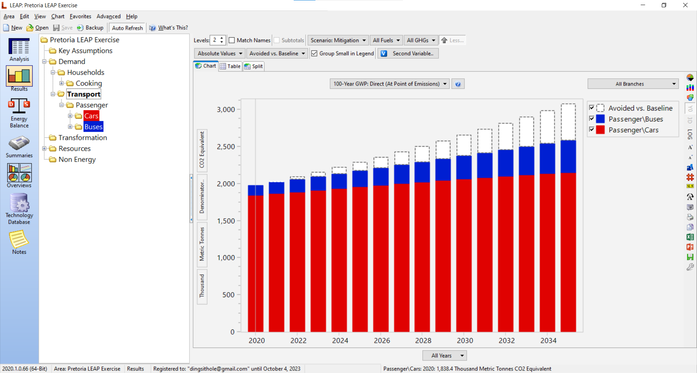

Slide 21
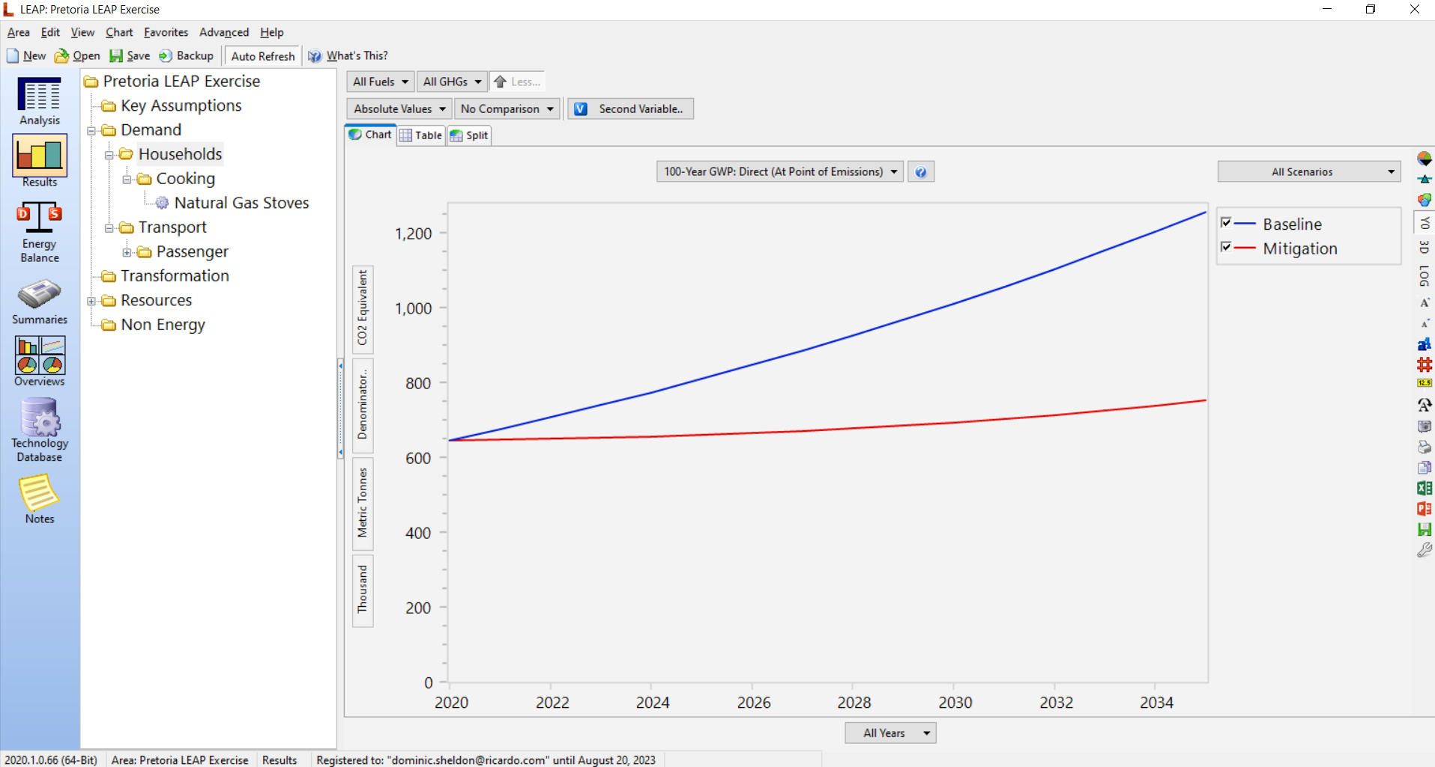

Slide 26
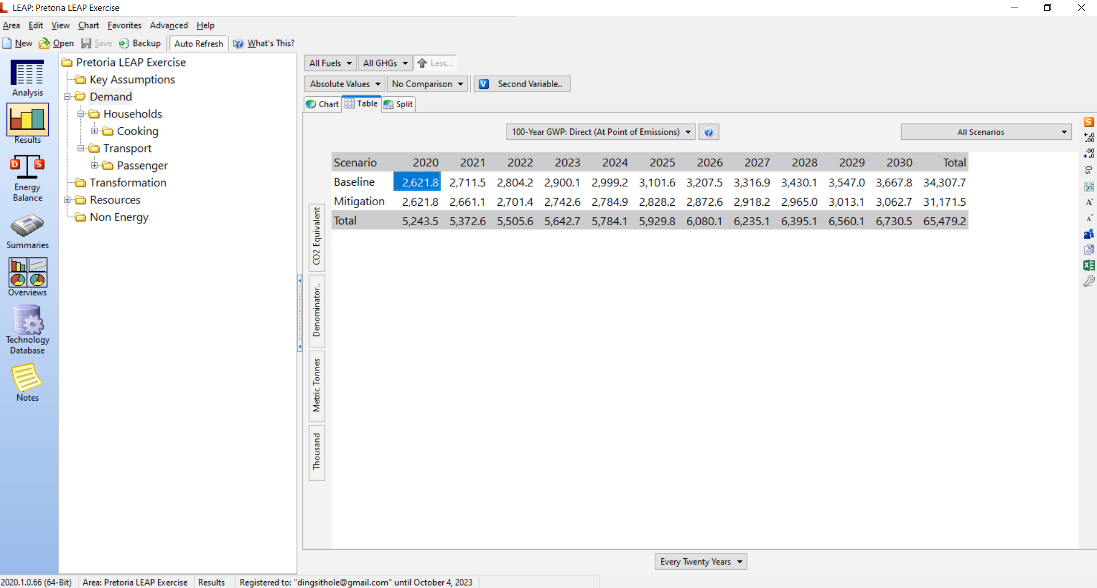

Slide 28
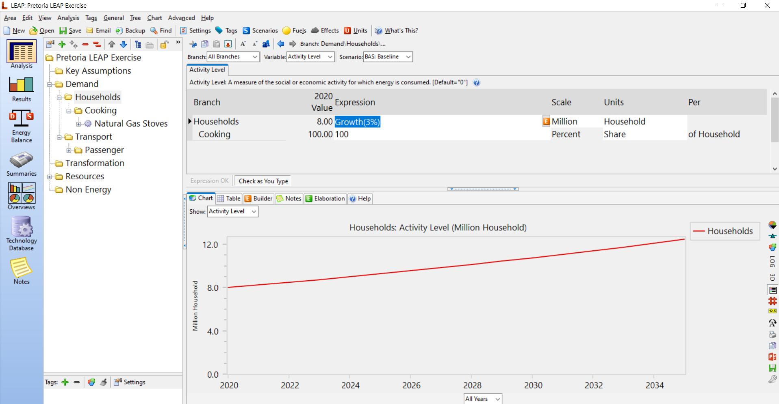

Slide 30
Basic structure of LEAP model: The Tree and its branches
Target: 40% energy efficiency savings by 2035
Households
Cooking
Natural gas
Emissions
Demand
Cars
Gasoline
Emissions
Transport
Passenger
Road
Buses
Diesel
Emissions
Target: 30% modal shift from cars to buses

Slide 31
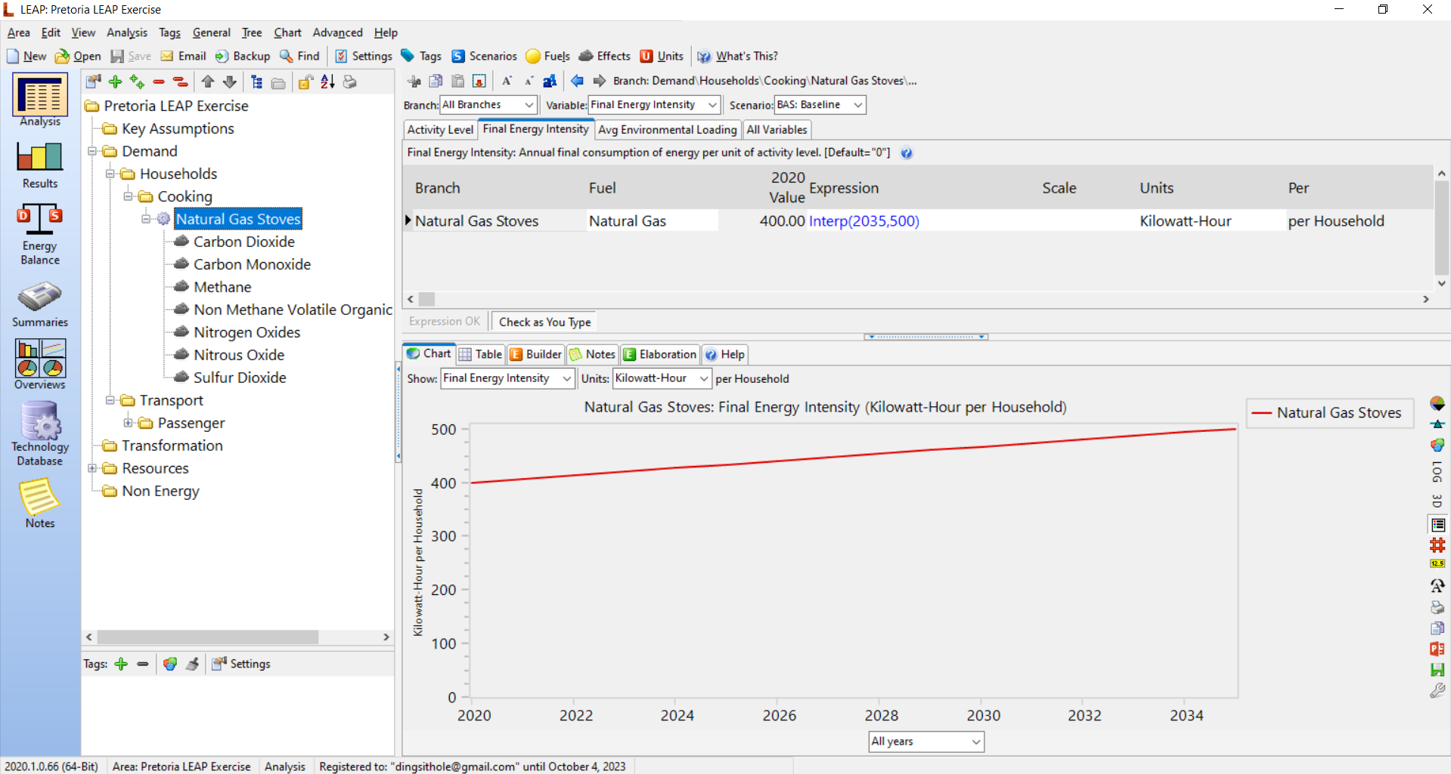

Slide 32
