Slide 1
The ETF Reporting Tools (test version)
Tracking Progress of the Mitigation Commitments of Nationally Determined Contributions (NDCs)
Training Workshop for Asia Region
Seoul, Republic of Korea – 11-13 Sep 2023
Lonava Tahreen, Transparency Division

Slide 2
Table of Contents
Background and Timeline of the ETF Reporting Tools
Scope of the Test Version
Using the ETF Progress Reporting Tool

Slide 3
ETF from Paris to Glasgow
Paris COP 21
Art 13 of PA defined ETF of action/support – Decision to report
Katowice COP24
Modalities, procedures and guidelines (MPGs) for ETF – What to report?
Glasgow COP26
Guidance for operationalizing the MPGs for ETF – How to report?

Slide 4
Tools for Reporting under ETF
Key outcomes on ETF at COP 26 (Glasgow) in 2021
Finalized discussions on the MPGs for ETF (decision 5/CMA.3) and adoption of: Common reporting tables (CRT) for reporting the GHG inventories Common tabular formats (CTF1) for tracking progress in implementing NDCs Common tabular formats (CTF2) for FTC support provided and mobilized Outlines of the Biennial Transparency Report (BTR) & national inventory document (NID) Training programme for technical experts participating in reviews First BTRs are due by 31 December 2024
Reporting tools

Slide 5
Background
Requested SBSTA to develop, pursuant to the MPGs:
common reporting tables (CRT) for the electronic reporting of info on GHG emissions
common tabular formats (CTFs) for the electronic reporting of info on tracking progress in achieving NDCs and of info on financial, technology development/transfer and capacity-building (FTC) support
Requested the secretariat to:
Develop the reporting tools, taking into account the flexibility provisions
Make available a test version by June 2023 and a final version of the tools by June 2024 (timely availability of sufficient financial resources)
Inform Parties on the progress at SBSTA sessions
Organize regular technical training workshops
Prepare a report on how the inputs of Parties on the test version have been considered
Facilitate interoperability with the IPCC inventory software and invite IPCC to engage in the work incl. by completing a mapping exercise between 2006 IPCC GLs and CRT
Establish an interactive web portal by Dec. 2025 to facilitate the availability of FTC support info
Decision 18/CMA.1
Adopted:
CRT for the electronic reporting of the info in the national inventory reports of GHG emissions
CTF for the electronic reporting of the info on tracking progress in achieving NDCs
CTF for the electronic reporting of the info on FTC support
Decision 5/CMA.3
Decision 5/CMA.3

Slide 6
Tools for Reporting under ETF
Key outcomes on ETF at COP 26 (Glasgow) in 2021
Finalized discussions on the MPGs for ETF (decision 5/CMA.3) and adoption of: Common reporting tables (CRT) for reporting the GHG inventories Common tabular formats (CTF1) for tracking progress in implementing NDCs Common tabular formats (CTF2) for FTC support provided and mobilized Outlines of the Biennial Transparency Report (BTR) & national inventory document (NID) Training programme for technical experts participating in reviews First BTRs are due by 31 December 2024
Reporting tools

Slide 7
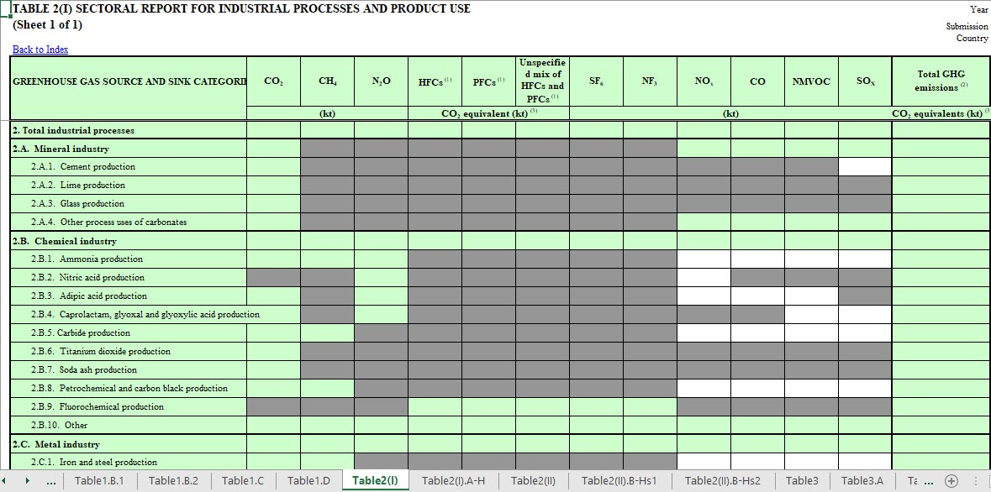
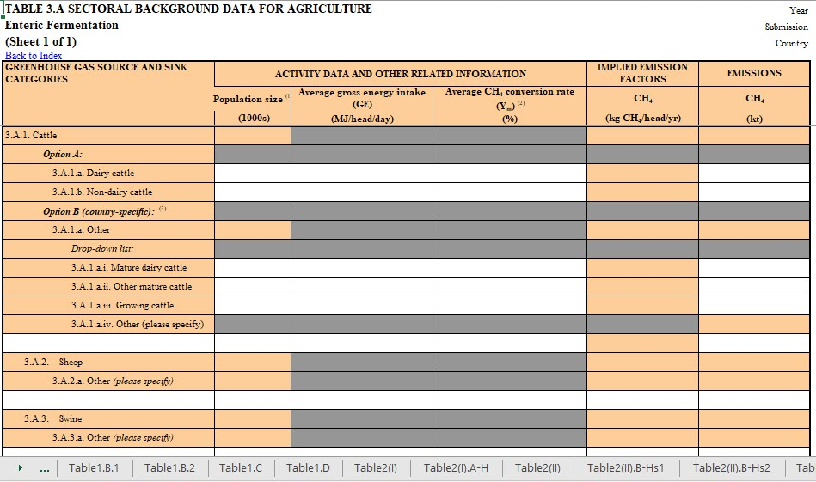
CRT for Reporting GHG Inventories

Slide 8
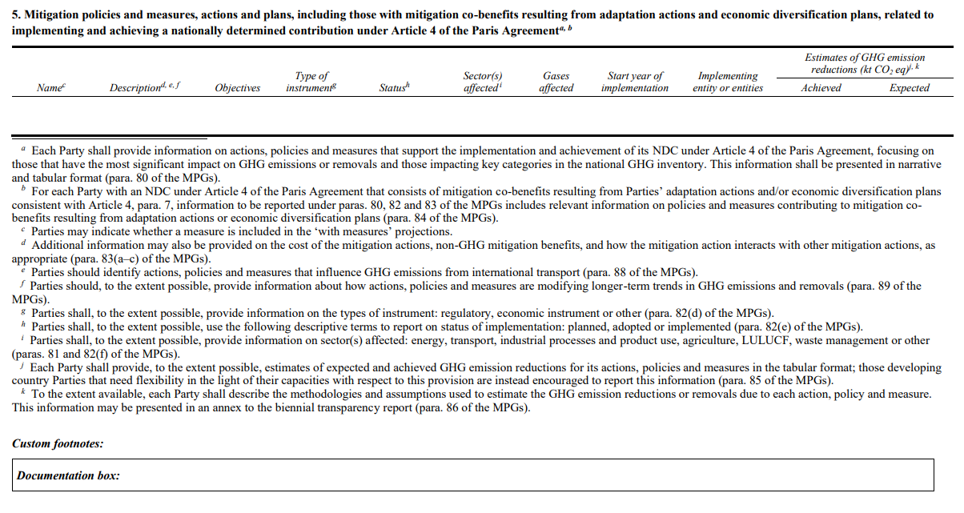
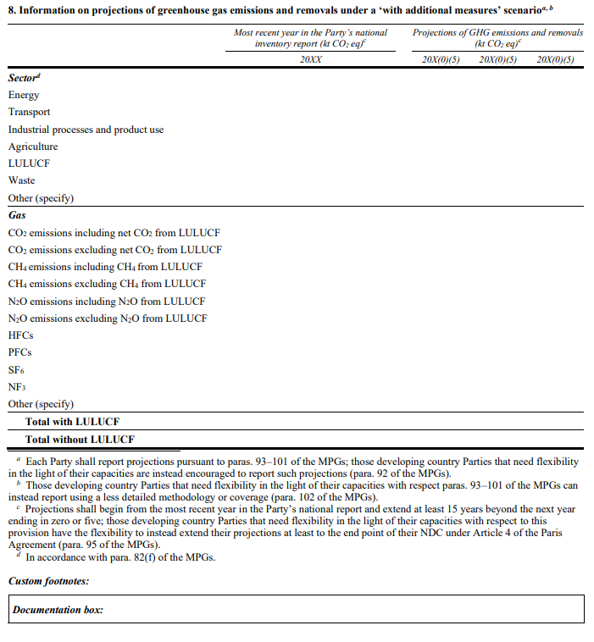
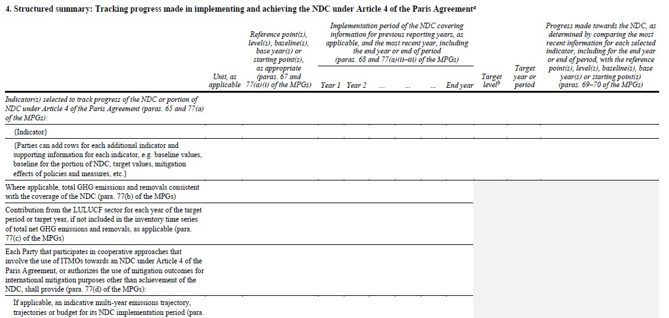
CTF for Tracking Progress in Implementing NDCs

Slide 9
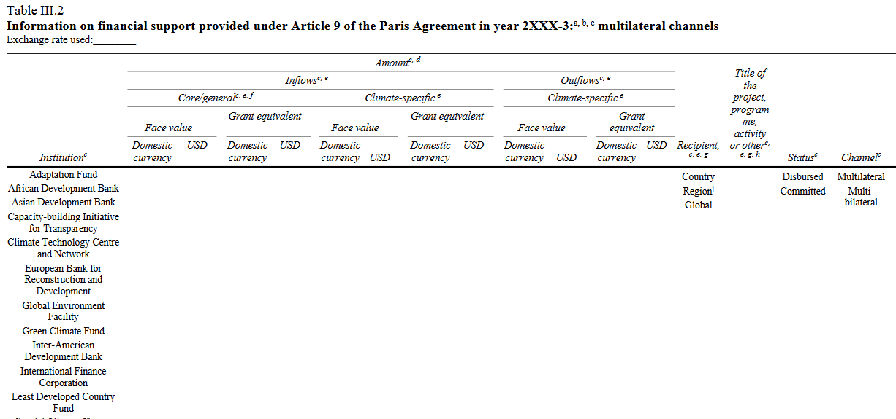
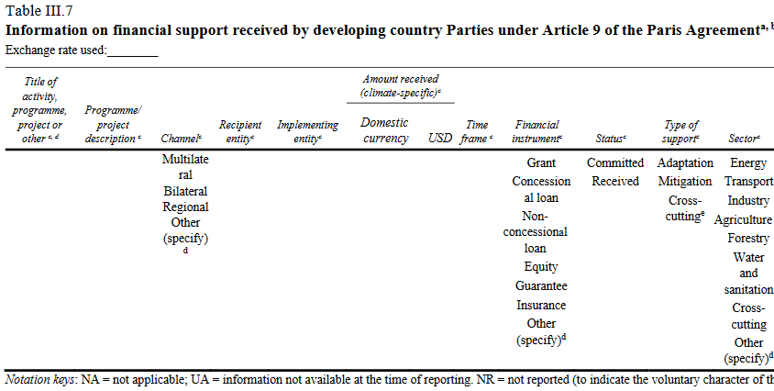
CTF for FTC Support Provided and Mobilized

Slide 10
Implementation Approach - IT Project

Slide 11
Assumptions
Parties submit the mandatory information and data in the formats agreed - comprehensive analysis, comparison, and assessment of progress - feed info into the GST and NDC cycles
Complex IT project covering the development of 3 new reporting tools using a common framework:
ETF GHG Inventory Reporting Tool = CRT (Common Reporting Tables for GHG emissions)
ETF Progress Reporting Tool = CTF NDC (Common Tabular Format for tracking progress in achieving NDC)
ETF Support Reporting Tool = CTF FTC (Common Tabular Format on finance, tech. and CB support)
UNFCCC institutional knowledge and experience (CRF Reporter, BR CTF, etc.) & Parties/experts views
New tools require additional skills, expertise and coordination, apart from solving countless technical aspects
Complexity:
All Parties, incl. ~150 developing countries; 3,000+ users
Online/offline; flexibility provisions
Interoperability with IPCC software
Timing & Funding

Slide 12
Complexity
Elevated level of complexity - dependencies among the modular building blocks
IT architecture - interconnected and inter-dependent technical engines:
Rendering engine: render and input data, providing an accessible, user friendly, streamlined interface
Validation engine: validation services (defined by metadata) in browser and server-side
Calculation engine: data calculation services (defined by metadata) in browser and server-side
Metadata engine: dynamically structure and validate data following a metadata schema (CMA decisions)
Import/export engine: import/export data drafts across client and server, including a compatibility layer with the IPCC Inventory software
Reporting engine: generate the agreed reporting tables in Excel based on the data entered
Storage engine: offline structured storage for applications using browser Web Storage facilities
User management and authentication reuse standard UNFCCC services

Slide 13
Timeline – Current Implementation phase
2023
Implementation & testing phase
Stage 3
Stage 4
Jan
Feb
Mar
Apr
May
Jun
Jul
Aug
Sep
Oct
Nov
Dec
1st release
2nd release
Continuing development of the tools
Reporting the progress to SBSTA incl. a live demo
Provide the test versions of the ETF reporting tools to Parties
Submissions by Parties on their experience in using the tools
Conducting user acceptance testing of the tools
Organize regular trainings to Parties (esp. developing countries)

Slide 14
Timeline - 2024
2024
Implementation & testing phase
Stage 4
Stage 5
Jan
Feb
Mar
Apr
May
Jun
Jul
Aug
Sep
Oct
Nov
Dec
Continuing development of the tools
Operation & maintenance of tools
Reporting the progress to SBSTA
Provide the final version of the
ETF reporting tools to Parties
Report on how comments on the test version of the tools were considered in the final version
Conducting user acceptance testing of the tools
Organize regular trainings to Parties (esp. developing countries)

Slide 15
Scope of the Test version of the new ETF reporting tools

Slide 16
Scope for the test version
GHG Inventory:
Energy sector – all tables (12)
Waste sector – all tables (5)
Interoperability with IPCC Inventory Software
ETF Progress:
Mitigation policies and measures, actions and plans – Table 5
Information on projections of greenhouse gas emissions and removals:
Table 7 (with measures)
Table 8 (with additional measures)
Table 9 (without measures)
Key underlying assumptions and parameters used for projections – Table 11
ETF Support:
Financial support mobilized through public interventions – Table III.3
Support needed: Financial – Table III.6
Support received: Financial – Table III.7

Slide 17
Looking ahead
Continuing development of the back-end solution and UI/UX design
Conducting in person hands-on trainings and virtual Q&A sessions
Continuing the work with IPCC for the interoperability with IPCC software
Mid-November - second release of the test version of the ETF reporting tools
Provision of user support incl. quick start guide (guidance to users) and email for raising technical issues
Parties' views and feedback - to be submitted officially via the submission portal
Initiating the preparatory work on the new ETF review tools and Data Warehouse Project

Slide 18
ETF PROGRESS
Reporting Tool
Live Demonstration

Slide 19
ETF | PROGRESS Reporting Tool
The test version release is for testing/training only
Please DO NOT initiate work on an official submission with the current test version of the ETF Reporting tool as there could be data losses due to multiple releases and version deployments

Slide 20
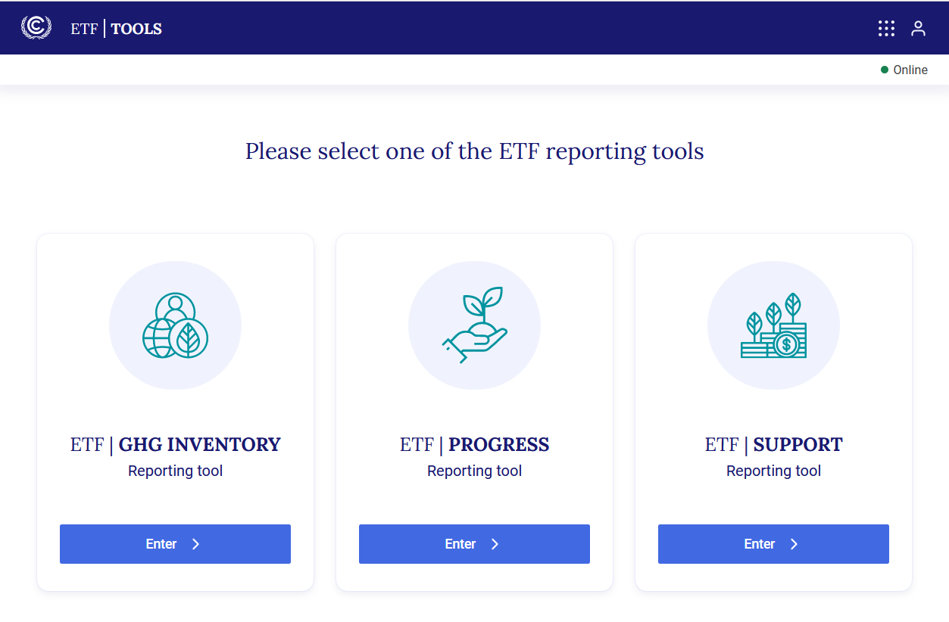
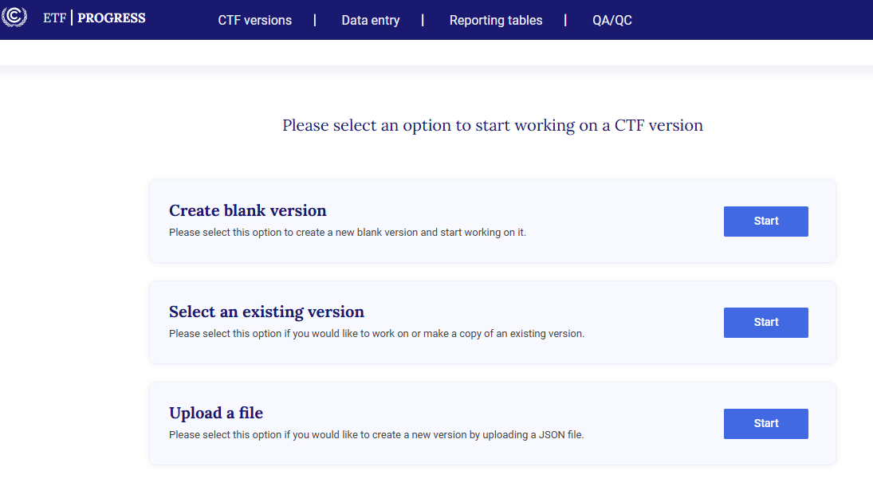
ETF | PROGRESS Reporting Tool
Homepage - https://apps.unfccc.int/home
Use any internet browser (e.g., Firefox, Edge, Chrome, or Safari) on your PC.
Access and Create a new Version
Specify year and version type
Landing Page
Create a new version
Notes:
Create a blank version
Show a pre-filled JSON File upload

Slide 21
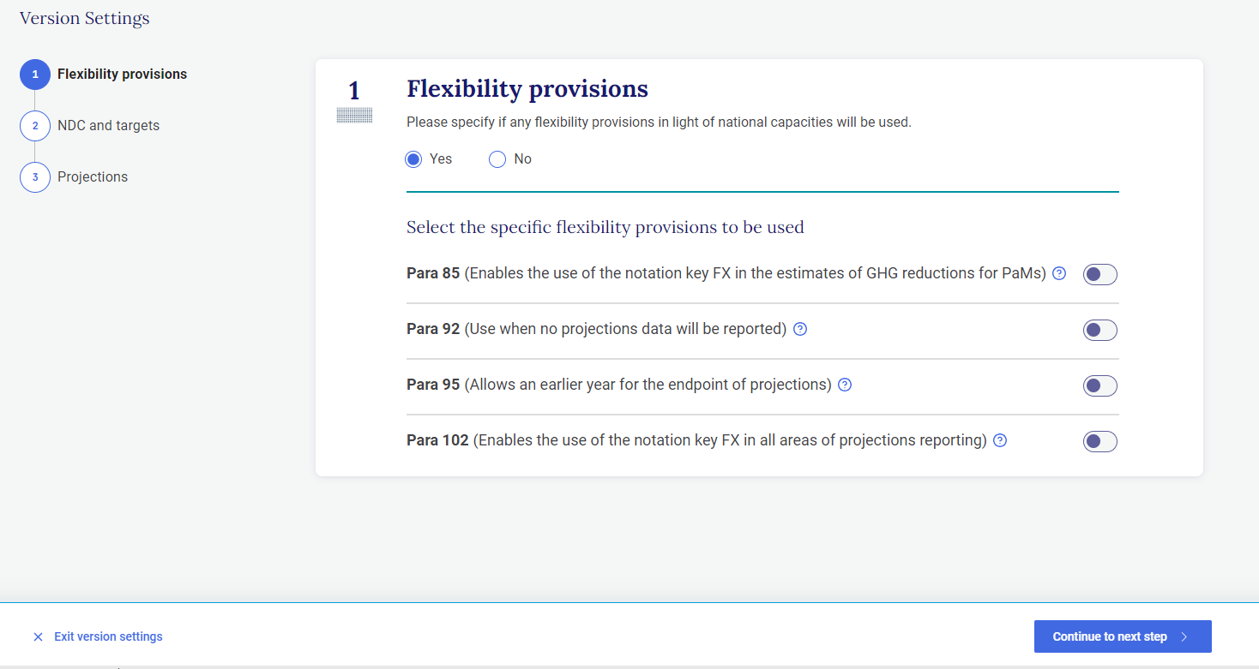
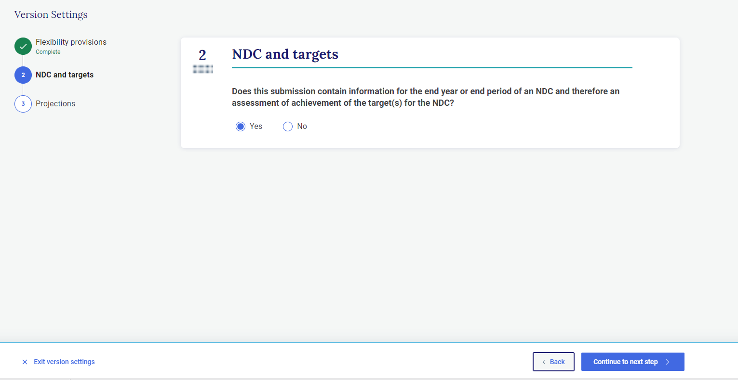
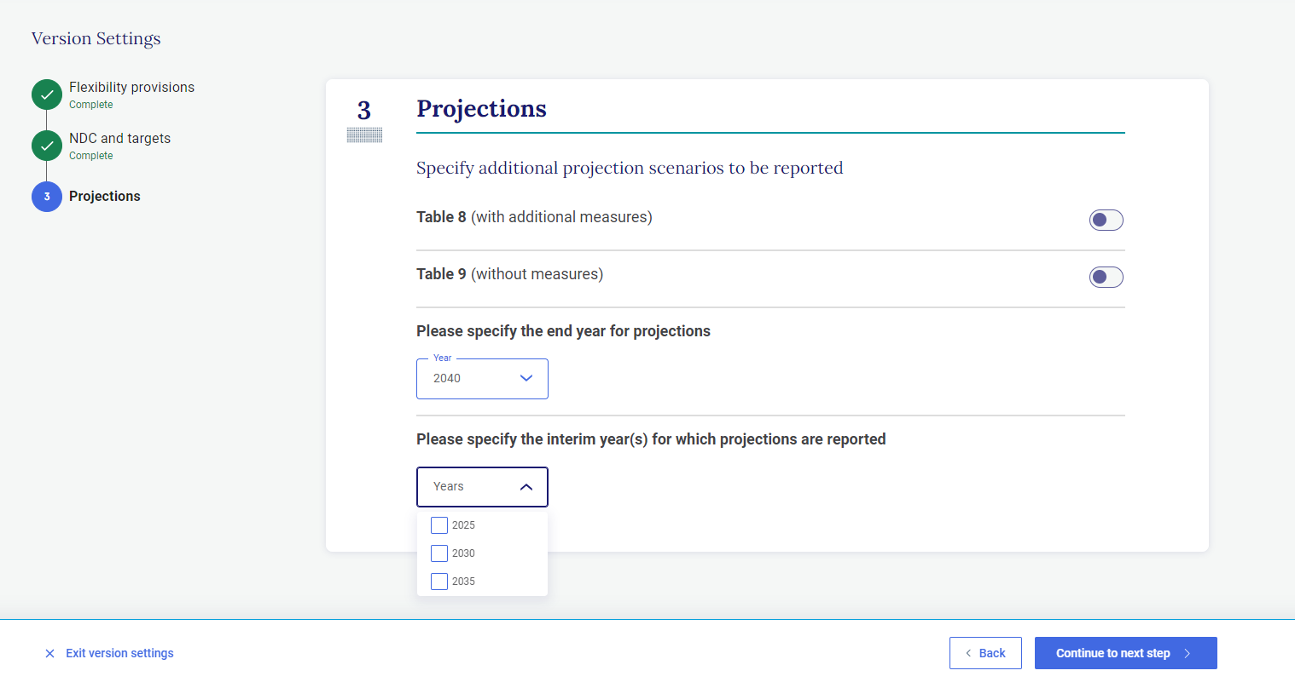
ETF | PROGRESS Reporting Tool
Specify version settings, applicable flexibility provisions
Specify YES/No to Flexibility
Application of flexibility options as applicable
Specify projection settings
Notes:
Demo each Para flexibility: Para 85, Para 92, Para 95 and Para 102
Selection of NDC and targets question
To generate Table 8 and Table 9
Show the difference in years according to the MPGs

Slide 22
ETF | PROGRESS Reporting Tool
Scope of reporting
Para 85
Frequency of reporting
Para 92
Flexibility
Level of detail of reporting
Para 95
Para 102
Scope of the review
Notes:
Para 85: Each Party shall provide, to the extent possible, estimates of expected and achieved GHG emission reductions for its actions, policies and measures in the tabular format referred to in paragraph 82 above; those developing country Parties that need flexibility in the light of their capacities with respect to this provision are instead encouraged to report this information.)
Para 92 (reporting projections)
Each Party shall report projections pursuant to paragraphs 93–101 below; those developing country Parties that need flexibility in the light of their capacities are instead encouraged to report these projections.
Para 95 (end point for projections)
Projections shall begin from the most recent year in the Party’s national inventory report and extend at least 15 years beyond the next year ending in zero or five; those developing country Parties that need flexibility in the light of their capacities with respect to this provision have the flexibility to instead extend their projections at least to the end point of their NDC under Article 4 of the Paris Agreement.
Para 102 (less detailed methodologies or coverage)
Those developing country Parties that need flexibility in the light of their capacities with respect to paragraphs 93–101 above can instead report using a less detailed methodology or coverage.

Slide 23
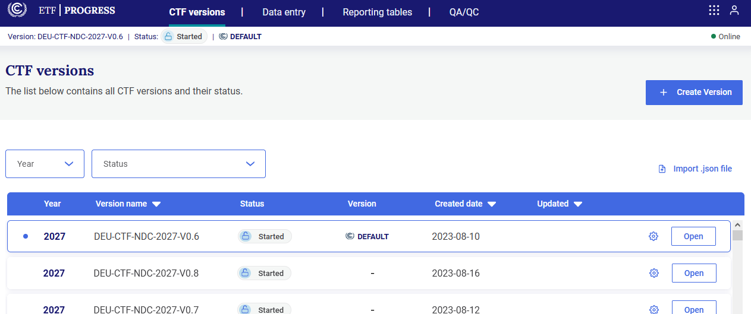
ETF | PROGRESS Reporting Tool
View versions, view and move through navigation tree
Access CTF Versions
Navigation Tree
Data Entry

Slide 24
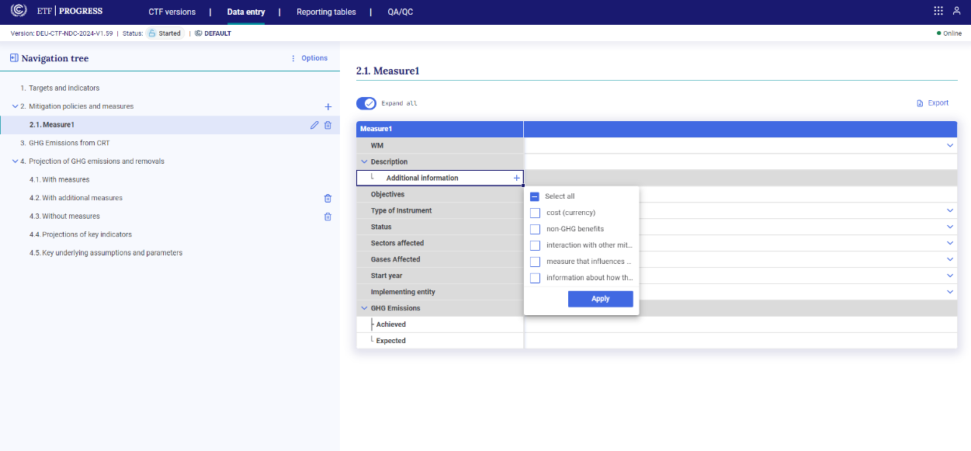
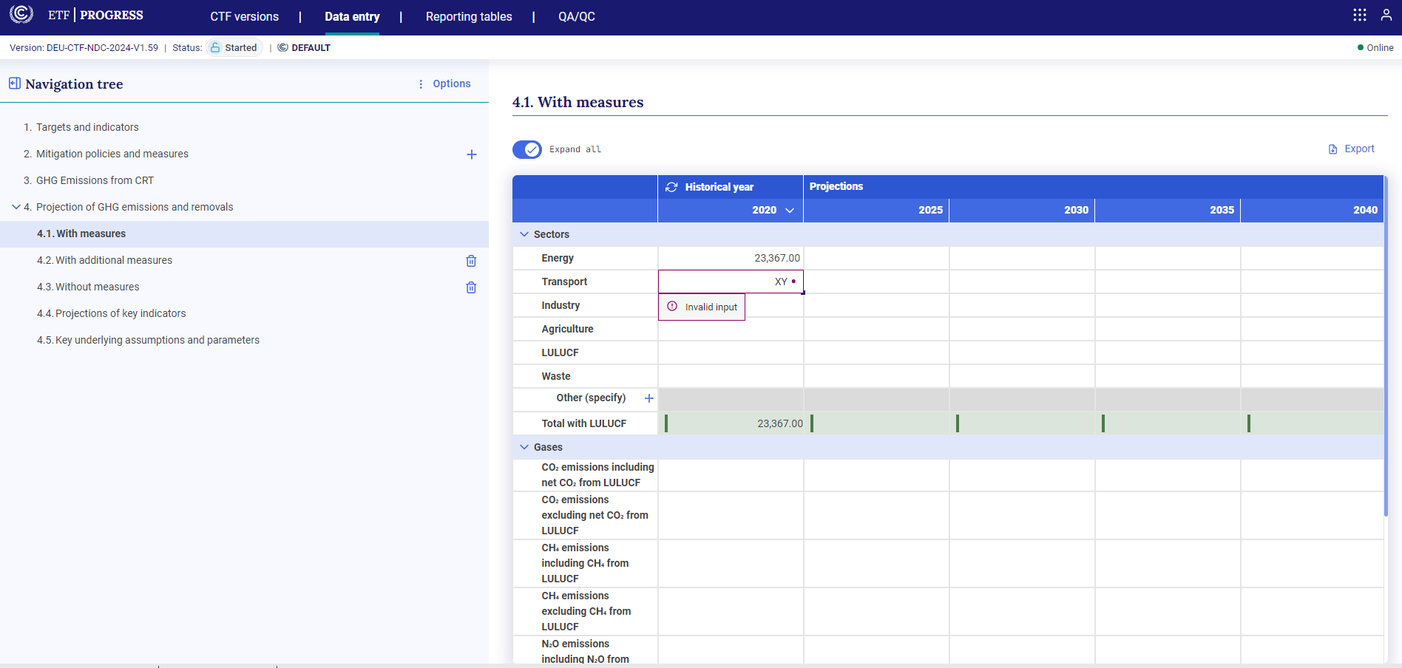
ETF | PROGRESS Reporting Tool
Entering data into the grids
Create records
Enter data
Modify data
Notes:
Add/modify data in the data entry grids
Data validation
Automatic calculation
You can create new nodes using the ‘+’ icon, and, if necessary, use the pencil icon to rename the node. Enter data in the node created.
You can add data in white cells; the application will check validity of data and provide indication if data is invalid (eg. use of standard notation keys and positive numbers in certain numeric cells)
Data in green shaded cells are automatically calculated based on data entered in the white cells (eg. totals)

Slide 25
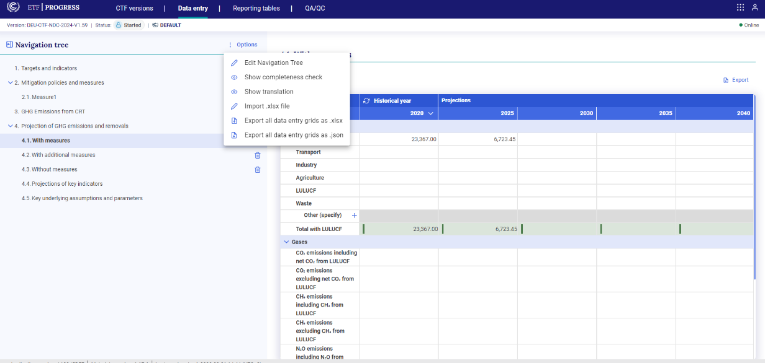
ETF | PROGRESS Reporting Tool
Export/import of data entry grids to Excel
Modify data
Export
Import data into version

Slide 26
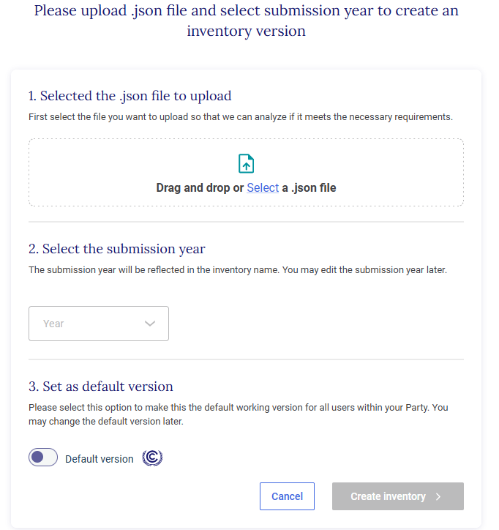
ETF | PROGRESS Reporting Tool
Export/import data entry grids as a JSON file, add/edit data there and import back into the application.
Modify data
Export
Import data into version
1. From initial version creation
2. From the CTF versions tab

Slide 27
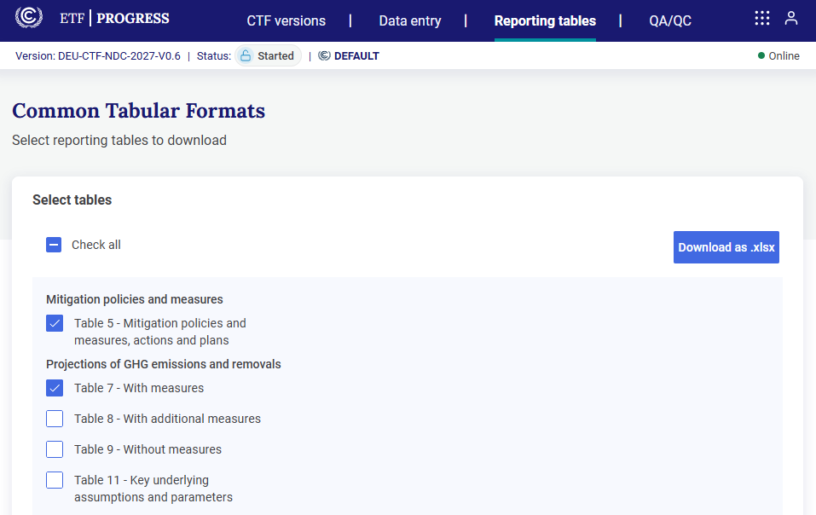
ETF | PROGRESS Reporting Tool
Generate/download static reporting tables
Select Reporting Tables
Download as .xlsx

Slide 28
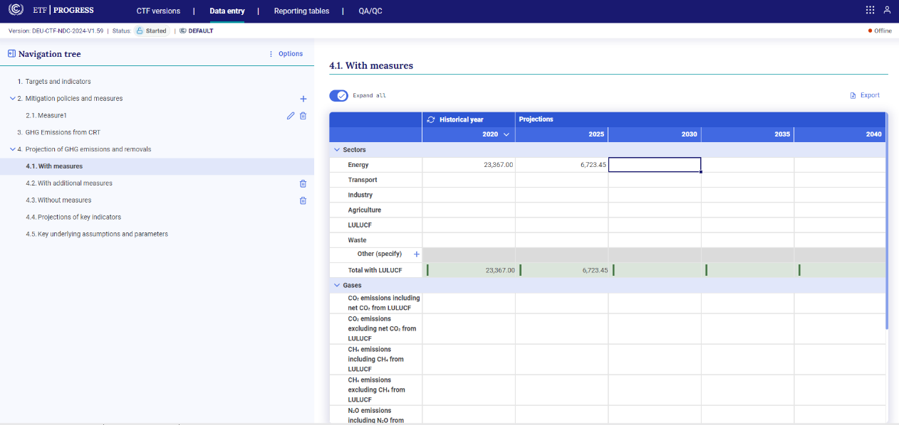
ETF | PROGRESS Reporting Tool
Work offline
Disconnected from internet (Offline button)
In Data Entry
Reconnected

Slide 29
Thank you!
Find out more at:
https://unfccc.int/Transparency
Join our LinkedIn group at:
https://www.linkedin.com/groups/13910606/
28

Slide 30
Some hands-on experience/training

Slide 31
ETF | PROGRESS Reporting Tool
Exercise 1
Create a new CTF version
Submission Year
Using Flexibility
Exercise 2
Create a new CTF version
Submission Year
Not using Flexibility
Projection Settings
Specify Interim Years

Slide 32
ETF | PROGRESS Reporting Tool
Exercise 3 - Navigation Tree and Data Entry grids
Mitigation Policies and Measures
Create a record
Enter data
Export the grid
Edit
Import back to the grid

Slide 33
ETF | PROGRESS Reporting Tool
Exercise 4 - Navigation Tree and Data Entry grids
Table 7, 8, 9 – With measures, With additional measures and Without measures
Enter data
Check the totals
Export data
Modify data
Import back to the grid
Add/delete a sector

Slide 34
ETF | PROGRESS Reporting Tool
Exercise 5 - Navigation Tree and Data Entry grids
Table 11– Key underlying assumptions and parameters
Specify key underlying assumptions/parameters
Select from the drop-down list
Specify the units used

Slide 35
ETF | PROGRESS Reporting Tool
Exercise 6 - Access CTF Versions Page
On the CTF Versions Tab
Check the year you are working on
Search for the CTF Version you are working on, click Open
To work on the Data Entry, click the Data Entry tab
Select the grid to work on from the Navigation Tree

Slide 36
ETF | PROGRESS Reporting Tool
Exercise 7 - Access the Reporting Tables
On the Reporting Tables Tab
Click on the table that you have worked on to download
Click the button ‘Download as .xlsx’
The table will be downloaded in excel format in your download folder
Please note, the output of these tables are still in development

Slide 37
ETF | PROGRESS Reporting Tool
Exercise 8 - Work offline
On Data Entry Tab
Enter data
Disconnect from the internet- Notice the online button turn red (offline)
Reconnect back
Export data to work offline and import back
Check seamless experience in both online and offline mode

Slide 38
Thank you!

