Slide 1
PATPA Regional Group Anglophone Africa: Reporting on adaptation through the Biennial Transparency Report 22-24 February 2022 Virtual event
Adaptation related information to be included in Biennial Transparency Reports
Motsomi Maletjane, Matti Goldberg
Adaptation Division, UNFCCC secretariat

Slide 2
UNFCCC arrangements involving adaptation information
REPORTING AND COMMUNICATION WITH ADAPTATION-SPECIFIC GUIDELINES
1999: National communications of annex I Parties (FCCC/CP/1999/7)
2019: new guidelines (6/CP.25)
NC portal
2002: National communications of non-annex I Parties (17/CP.8)
NC portal
2015/2018: ADCOMs (PA Art 7 + 9/CMA.1)
Public registry
2015/2018: BTRs (PA Art 13 + 18/CMA.1)
UNFCCC website
NATIONAL-LEVEL ADAPTATION PROCESSES WITH REPORTING / COMMUNICATION ASPECTS
2001: NAPAs
UNFCCC website
2010: NAPs (5/CP.17)
NAP Central
OTHER DOCUMENTS CONTAINING ADAPTATION INFORMATION
2014: Adaptation components of INDCs/NDCs (1/CP.20)
NDC registry
Low-emission dev. strategies (PA Art 4.19)
UNFCCC website

Slide 3
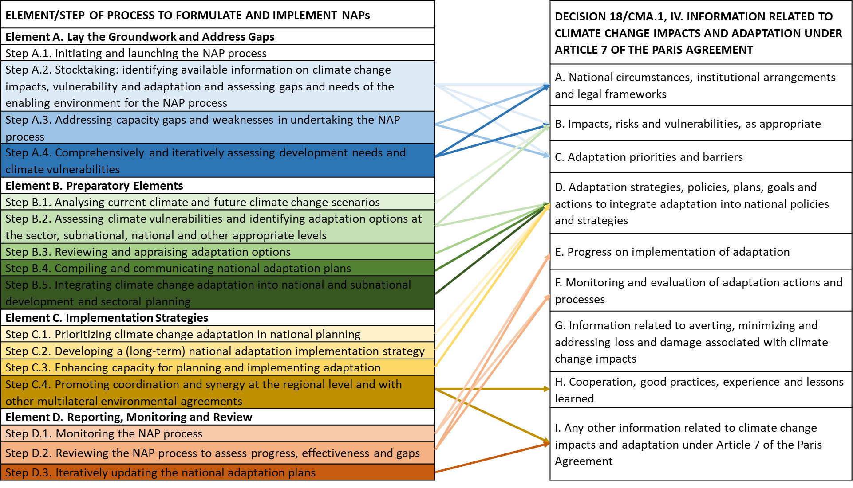
Potential information synergies between NAPs and BTRs

Slide 4
Criteria to assess adequacy and effectiveness in adaptation planning (UNEP, 2020 & 2021)
Criteria | Indicators
Comprehensiveness | Adaptation options comprehensively address assessed risks, impacts, hazards or vulnerabilities
Inclusiveness | Dedicated stakeholder engagement process in place Consideration of gender
Implementability | Presence of Central administrative body Regulations Investments Incentives
Integration | Presence of Sectoral adaptation plans and coordination mechanisms Subnational adaptation plans and coordination mechanisms
Monitoring and evaluation | M&E system in place Monitoring/Progress report published Evaluation undertaken and report published

Slide 5
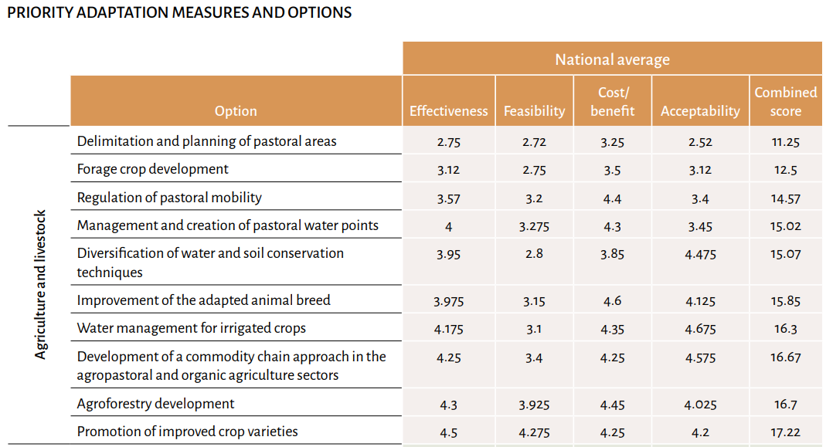
Comprehensiveness
Adaptation options comprehensively address assessed risks, impacts, hazards or vulnerabilities
The NAP summarizes assessment of impacts, vulnerability and risk, including a baseline
Presents adaptation priorities using multiple lenses (hazards, sectors, admin levels, scale, etc.);
Provides, in a transparent manner, the criteria used for ranking systems, vulnerabilities and risks, and adaptation options
Chad (2022)

Slide 6
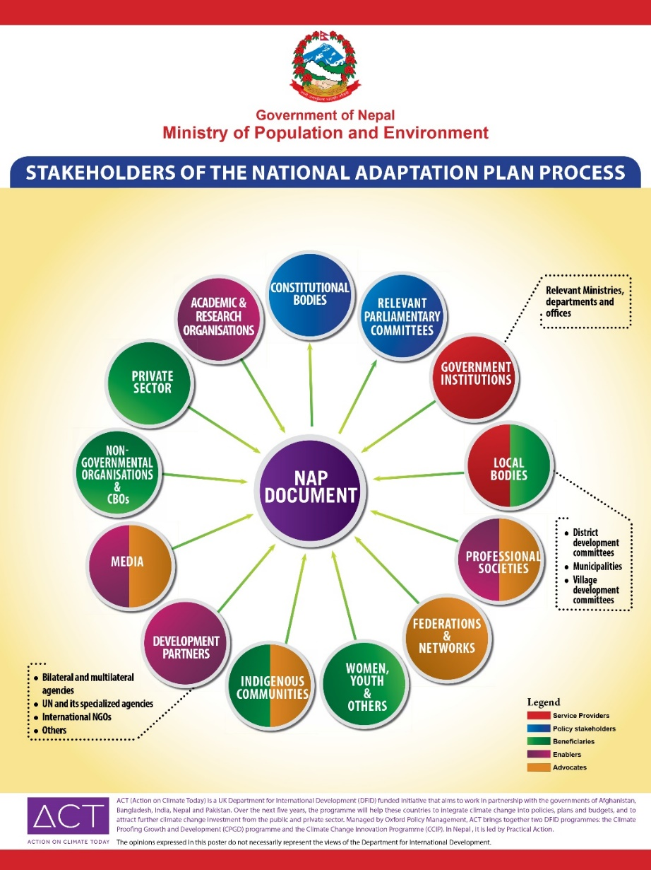
Inclusiveness
Stakeholder engagement; consideration of gender; etc.
The NAP serves as the national policy instrument for coordinating and driving actions of all actors and stakeholders in pursuit of adaptation goals and outcomes;
Stakeholders are engaged throughout the process from laying the groundwork and addressing gaps; assessments; implementation strategies; reporting, monitoring and review;
Example: Countries are increasingly engaging the full diversity of actors and stakeholders – e.g. majority of the NAPs submitted by the developing countries explicitly address gender and women (UNFCCC LDC Expert Group, 2021)

Slide 7
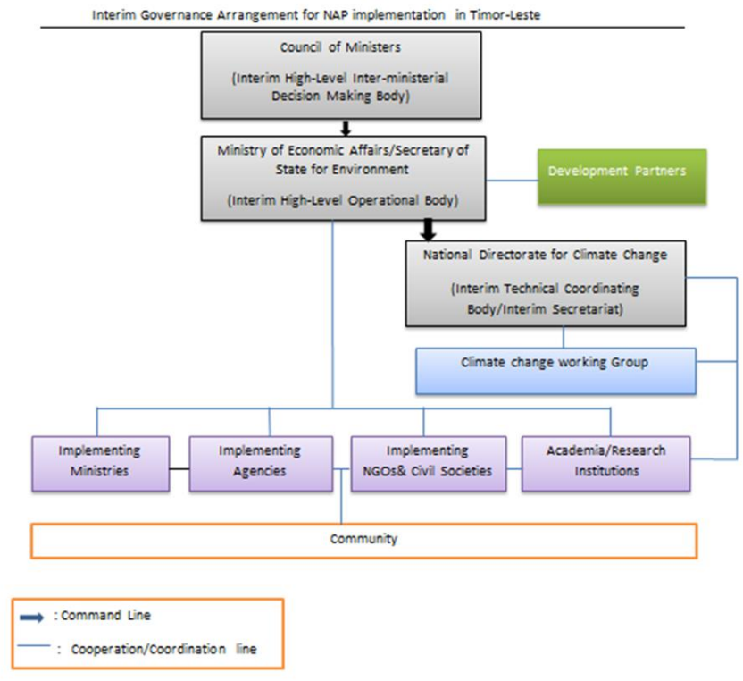
Implementability
Central administrative body; Regulations; Investments; Incentives
The NAP serves as a repository of adaptation actions such as through projects seeking support and financing to investors including the private sector and bilateral programmes;
Provides details on leadership and coordination arrangements; institutional, legal and regulatory frameworks guiding adaptation
The NAP would include adequate details to facilitate swift development and approval of projects and programmes for implementation of adaptation measures;
Alignment of priority activities with the GCF country programme for the country
Timor-Leste (2021)

Slide 8
Integration
Sectoral and subnational adaptation plans and coordination mechanisms
The NAP serves as the umbrella plan of action for adaptation for the country, embracing all other relevant national plans, sectoral strategies and plans at various subnational levels and where relevant, regional/transboundary plans;
It serves to manage coherence and synergy of climate change adaptation efforts with national development, SDGs, Sendai Framework, other intl., regional and national frameworks;
Example: integration into sectoral strategies; budget coding; integration of vulnerable groups, indigenous peoples, etc.; (UNFCCC LDC Expert Group, 2021)
In the formulation of County Adaptation Plans, counties will be encouraged to identify their priority actions from the actions presented herein and customise them to suit their county context after conducting risk/vulnerability assessments.
Kenya (2017)

Slide 9
Monitoring and evaluation
M&E system in place; Monitoring/Progress report published; Evaluation undertaken; report published
The NAP would clearly state goals, objectives and where possible, concrete targets to guide application of appropriate M&E systems in the future
It would provide a baseline of vulnerability, and give regular updates on vulnerability to inform assessment of progress in adaptation in relation to the global temperature goal of <2 °C and the global goal on adaptation

Slide 10
Motsomi Maletjane
Team Lead, Adaptation Committee Unit
Adaptation Division
E-mail: mmaletjane@unfccc.int
Thank you

