Slide 1
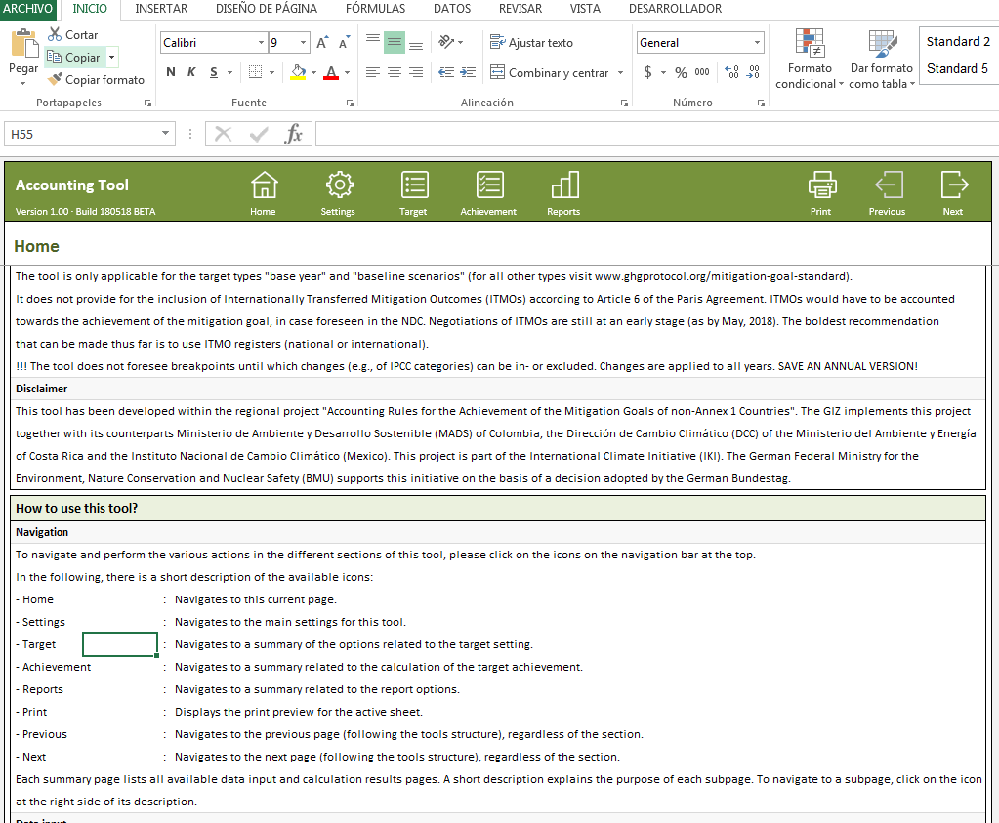
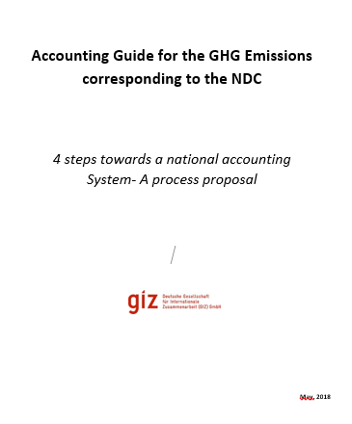
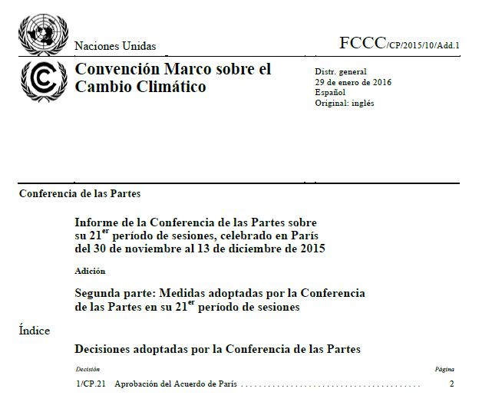
NDC Accounting is institutionalized
and
NDC Accounting Tool
Article 4.13
Webinar June 19, 2018, 8 am – 9 am (UTC+2) Welcome !
Subject: Presentation of a NDC Accounting Tool that is adjustable to national circumstances

