Slide 1

Day 2, 23rd of February 2022:
PATPA Anglophone African Regional Group
Virtual workshop on adaptation reporting through the Biennial Transparency Report (BTR)
February 22nd – 24th, 2022
Welcome, we will begin shortly
©Christina Morillo/Pexels

Slide 2
Virtual Workshop: 3 hours stretched over 3 days
Day 1
- Overview of the iterative adaptation process
- Questions and exchange about countries’ journey along this process
- Overview of planning instruments which feed into the BTR
- How to collect the information to develop them, and barriers faced
- Overview of the report-orientated instruments which feed into the BTR
- How to monitor and evaluate progress on planning
- Countries’ options for monitoring
- Country experiences
- Country experiences
Day 2
Day 3
> Through an interactive format and peer-learning

Slide 3
Today’s agenda – day 2
Opening remarks // Catarina Tarpo, PATPA and Clémence Moinier, Ricardo E&E
Adaptation planning components of the BTR – criteria to ensure the quality of the adaptation planning components which should be reported in the BTR // Motsomi Maletjane and Matti Goldberg, UNFCCC Secretariat
Q&A // All participants and Motsomi Maletjane
Gender-Responsiveness in adaptation planning and reporting // Funanani Muremi, Adaptation Committee
Interview // Minky Groenewald, Eswatini
Facilitated discussion in Breakout groups
  Reagan Chunga (Namibia)
  Minky Groenewald (Eswatini)
Adaptation-mitigation nexus plus Q&A // Clémence Moinier, Ricardo E&E
Evaluation & Feedback
Wrap up and the way forward // Clémence Moinier, Ricardo E&E

Slide 4
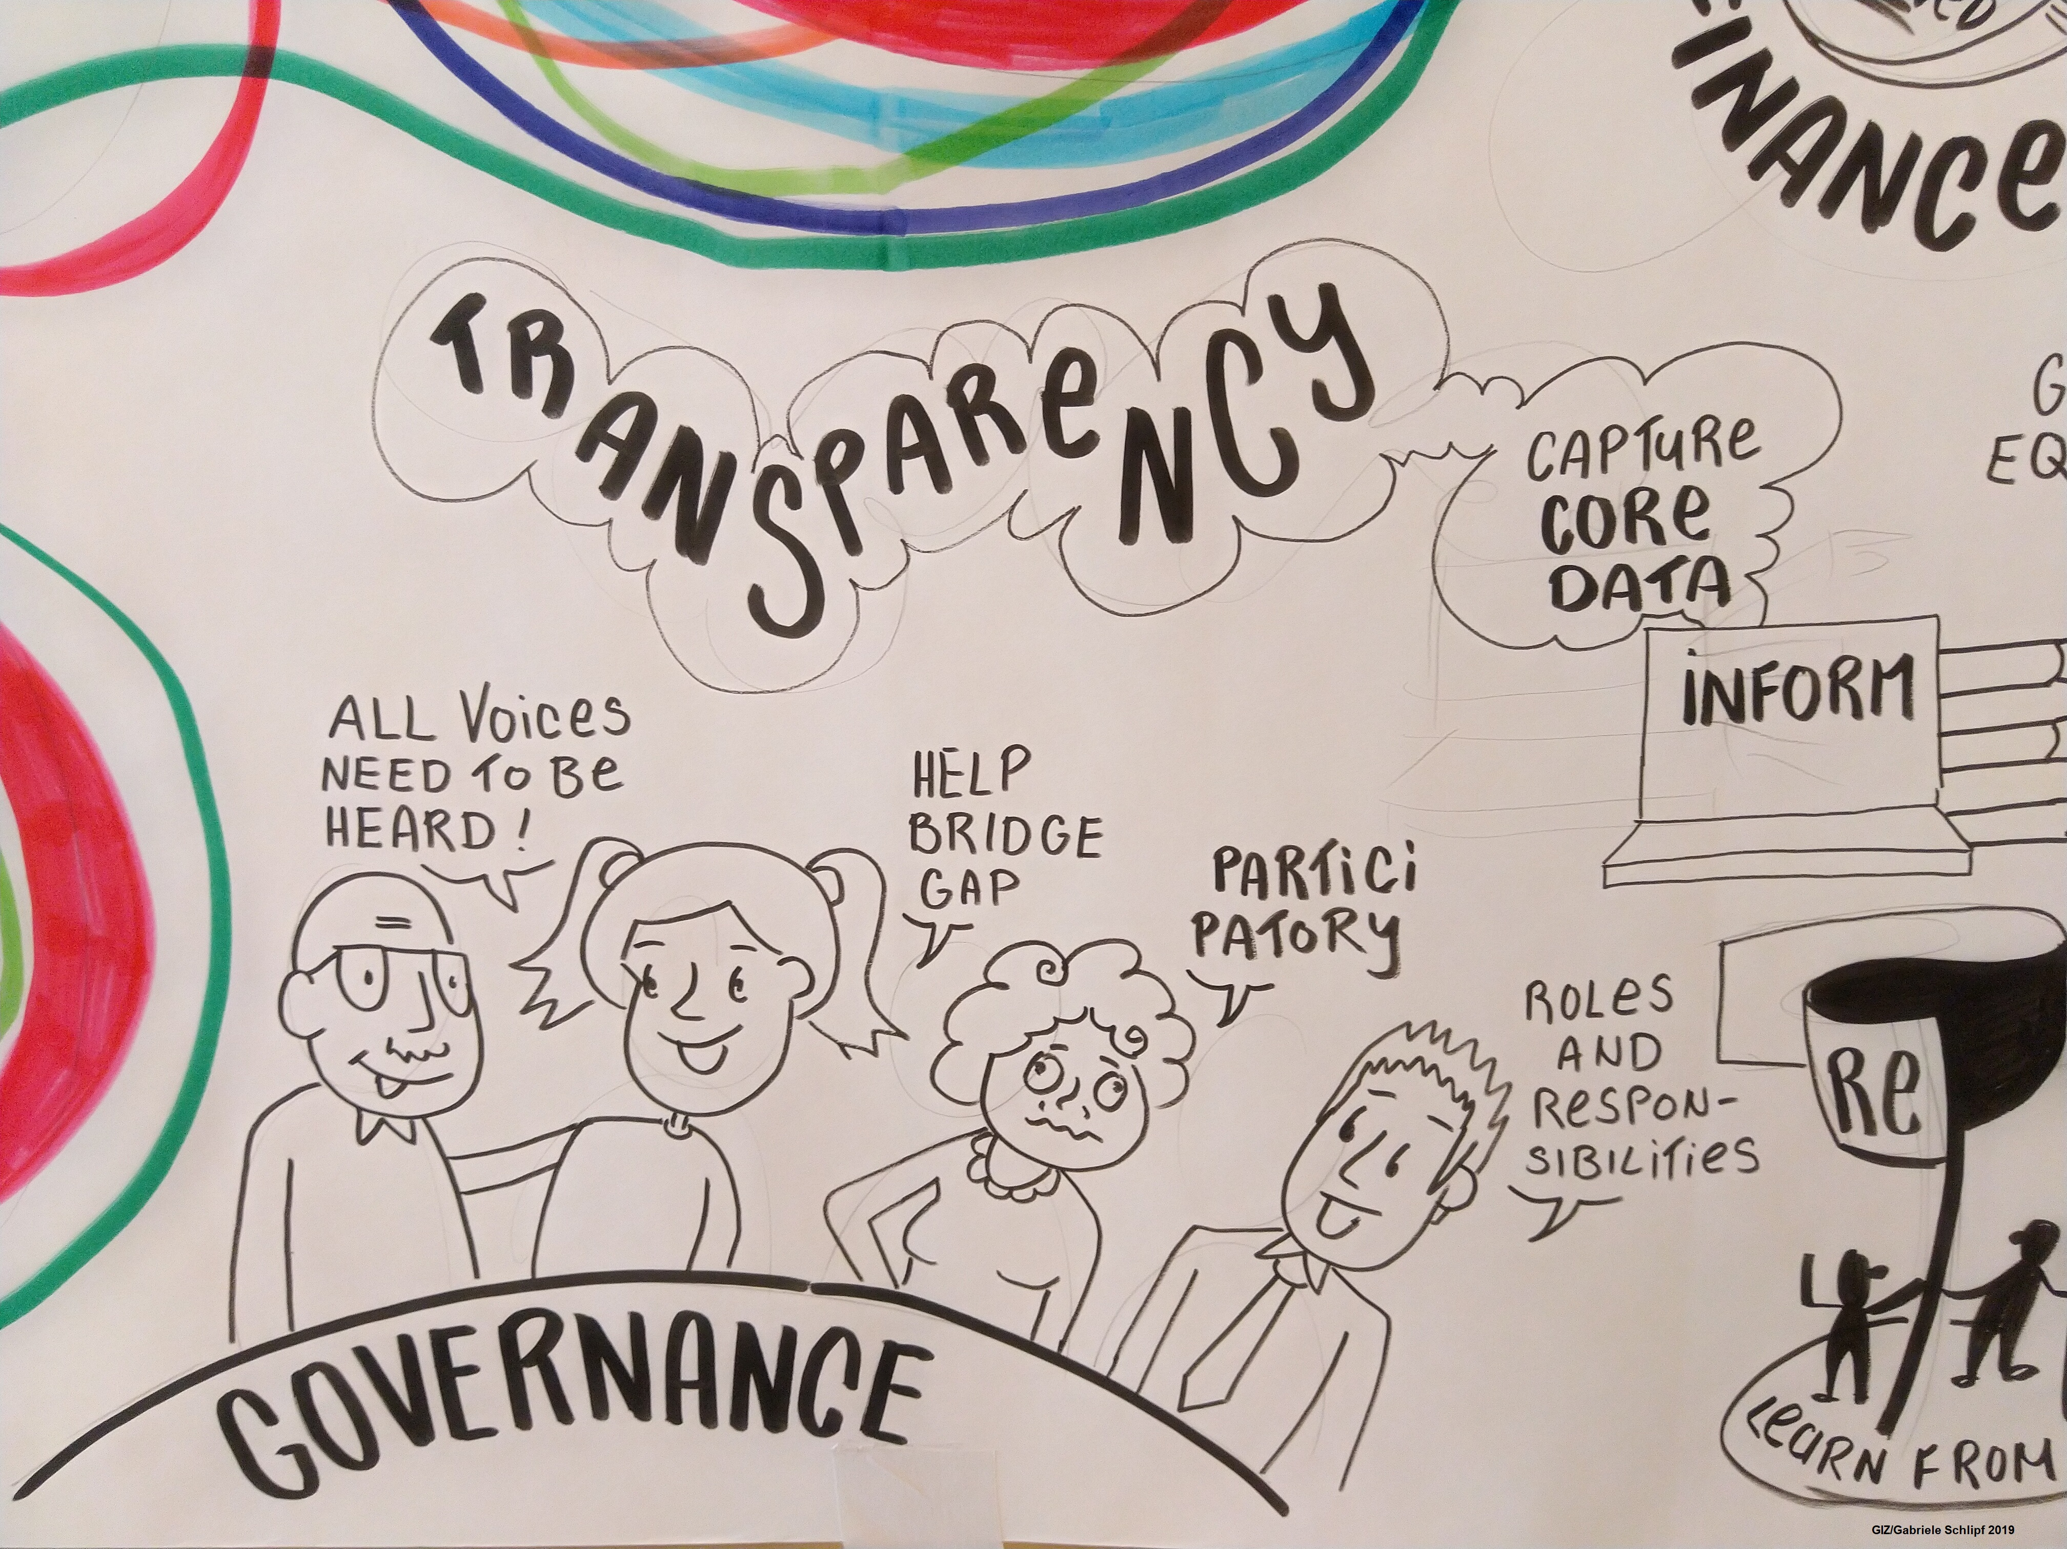


Adaptation planning components of the BTR – criteria to ensure the quality of the adaptation planning components which should be reported in the BTR
+ Q&A
Motsomi Maletjane and Matti Goldberg
UNFCCC Secretariat
©GIZ

Slide 5
PATPA Regional Group Anglophone Africa: Reporting on adaptation through the Biennial Transparency Report
22-24 February 2022
Virtual event
Adaptation related information to be included in Biennial Transparency Reports
Motsomi Maletjane, Matti Goldberg
Adaptation Division, UNFCCC secretariat

Slide 6
UNFCCC arrangements involving adaptation information
REPORTING AND COMMUNICATION WITH ADAPTATION-SPECIFIC GUIDELINES
1999: National communications of annex I Parties (FCCC/CP/1999/7)
2019: new guidelines (6/CP.25)
NC portal
2002: National communications of non-annex I Parties (17/CP.8)
NC portal
2015/2018: ADCOMs (PA Art 7 + 9/CMA.1)
Public registry
2015/2018: BTRs (PA Art 13 + 18/CMA.1)
UNFCCC website
NATIONAL-LEVEL ADAPTATION PROCESSES WITH REPORTING / COMMUNICATION ASPECTS
2001: NAPAs
UNFCCC website
2010: NAPs (5/CP.17)
NAP Central
OTHER DOCUMENTS CONTAINING
ADAPTATION INFORMATION
2014: Adaptation components of INDCs/NDCs (1/CP.20)
NDC registry
Low-emission dev. strategies (PA Art 4.19)
UNFCCC website

Slide 7
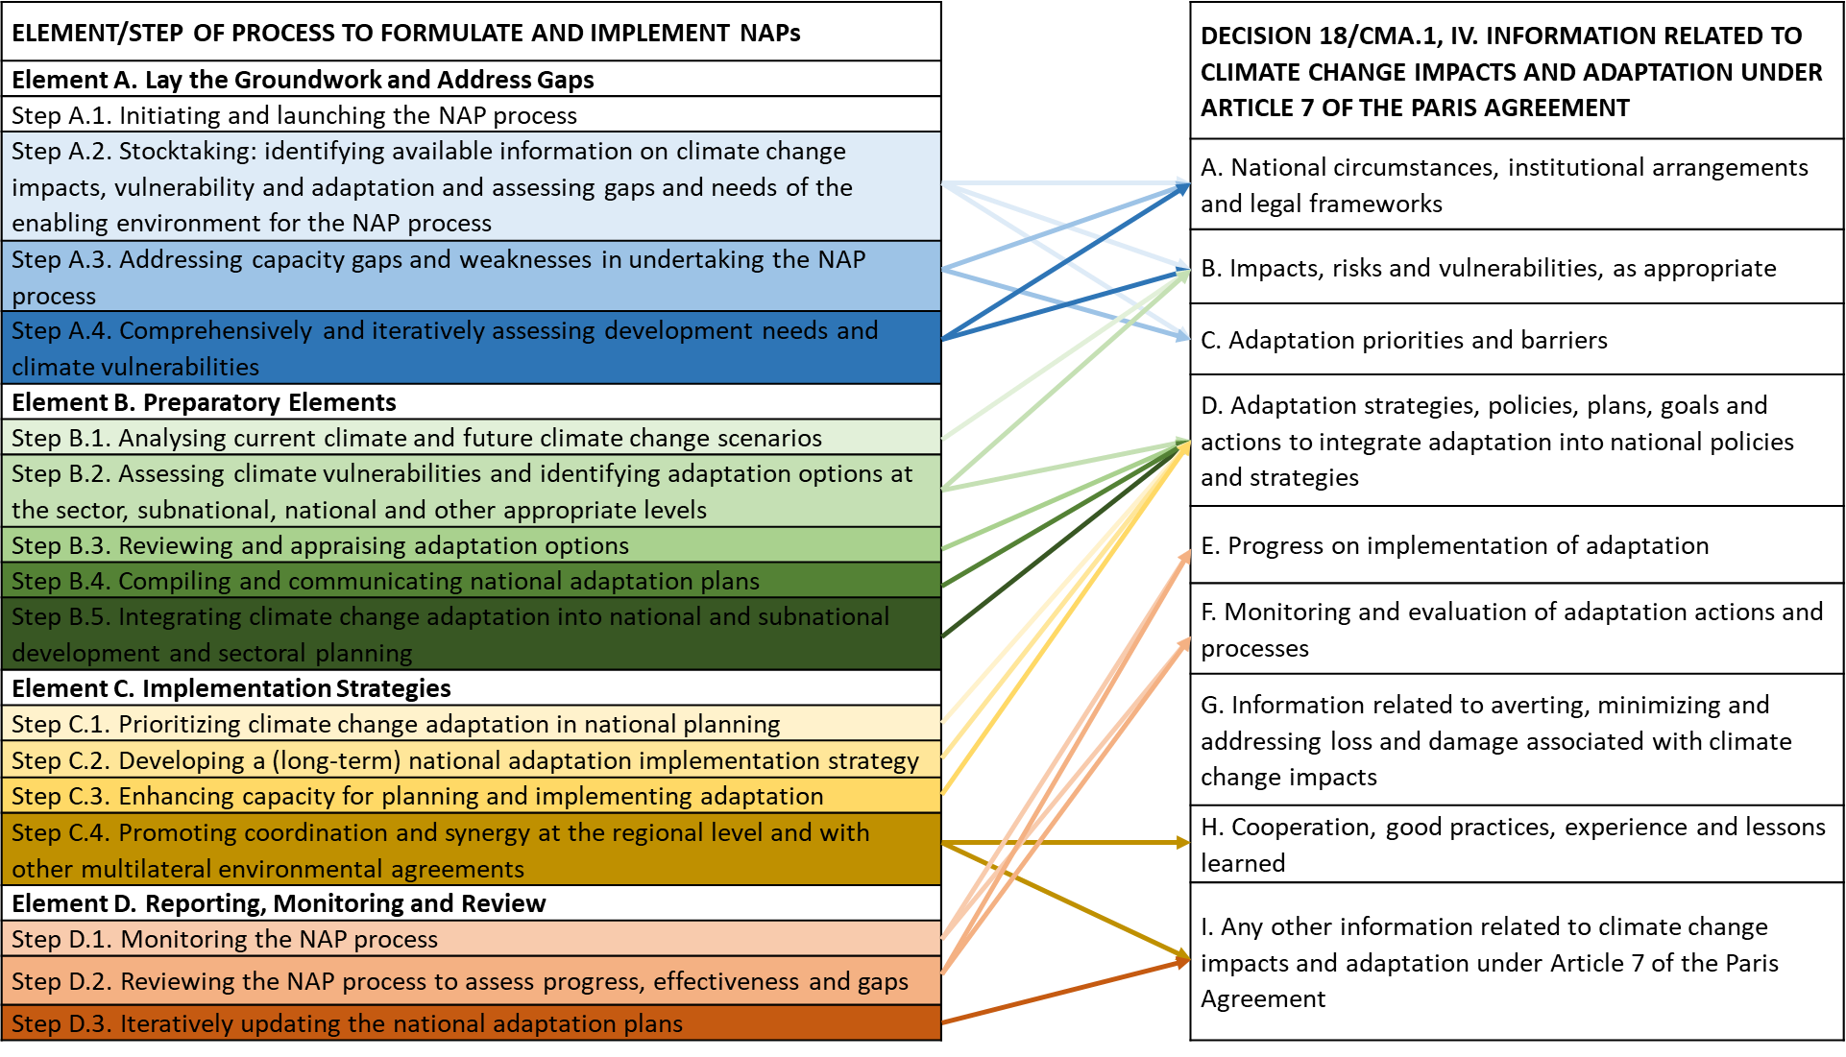
Potential information synergies between NAPs and BTRs

Slide 8
Criteria to assess adequacy and effectiveness in adaptation planning (UNEP, 2020 & 2021)
Criteria | Indicators
Comprehensiveness | Adaptation options comprehensively address assessed risks, impacts, hazards or vulnerabilities
Inclusiveness | Dedicated stakeholder engagement process in place Consideration of gender
Implementability | Presence of Central administrative body Regulations Investments Incentives
Integration | Presence of Sectoral adaptation plans and coordination mechanisms Subnational adaptation plans and coordination mechanisms
Monitoring and evaluation | M&E system in place Monitoring/Progress report published Evaluation undertaken and report published

Slide 9
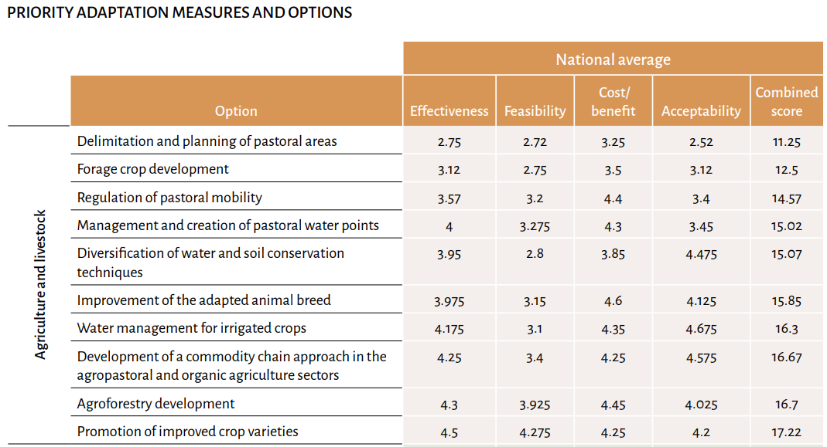
Comprehensiveness
Adaptation options comprehensively address assessed risks, impacts, hazards or vulnerabilities
The NAP summarizes assessment of impacts, vulnerability and risk, including a baseline
Presents adaptation priorities using multiple lenses (hazards, sectors, admin levels, scale, etc.);
Provides, in a transparent manner, the criteria used for ranking systems, vulnerabilities and risks, and adaptation options
Chad (2022)

Slide 10
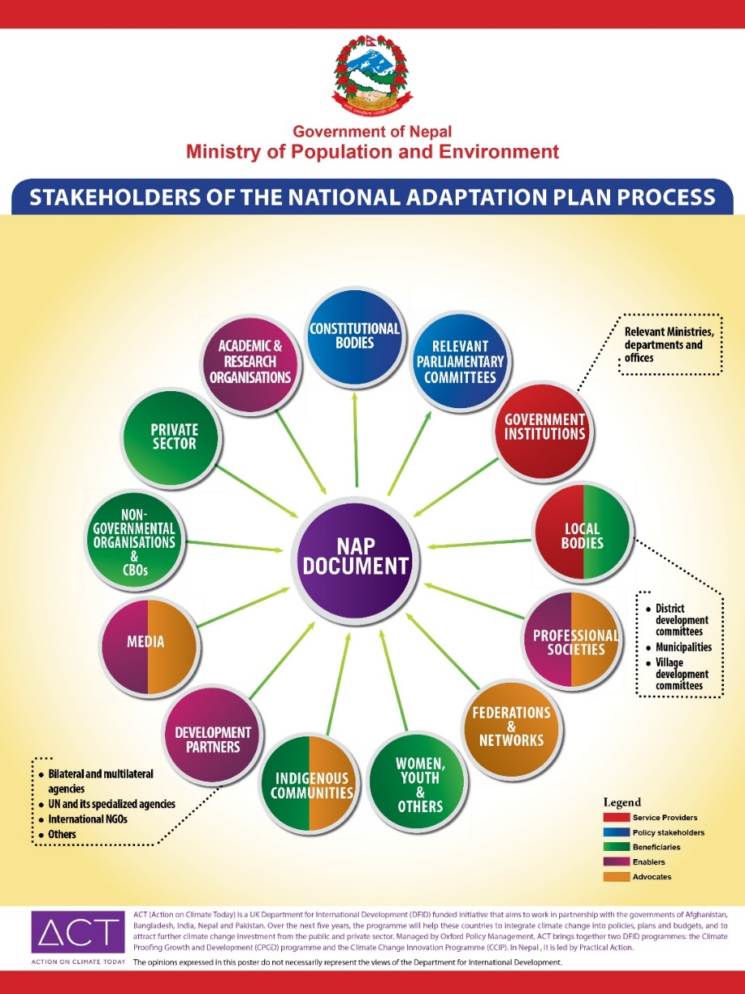
Inclusiveness
Stakeholder engagement; consideration of gender; etc.
The NAP serves as the national policy instrument for coordinating and driving actions of all actors and stakeholders in pursuit of adaptation goals and outcomes;
Stakeholders are engaged throughout the process from laying the groundwork and addressing gaps; assessments; implementation strategies; reporting, monitoring and review;
Example: Countries are increasingly engaging the full diversity of actors and stakeholders – e.g. majority of the NAPs submitted by the developing countries explicitly address gender and women (UNFCCC LDC Expert Group, 2021)

Slide 11
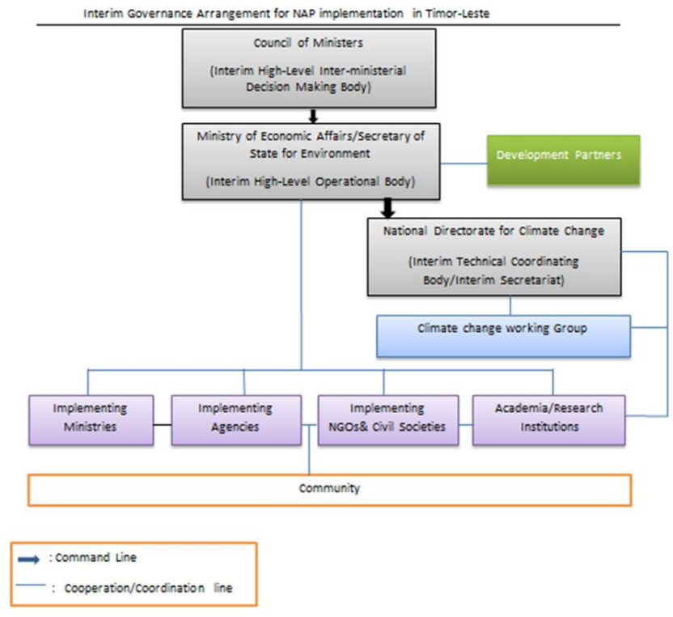
Implementability
Central administrative body; Regulations; Investments; Incentives
The NAP serves as a repository of adaptation actions such as through projects seeking support and financing to investors including the private sector and bilateral programmes;
Provides details on leadership and coordination arrangements; institutional, legal and regulatory frameworks guiding adaptation
The NAP would include adequate details to facilitate swift development and approval of projects and programmes for implementation of adaptation measures;
Alignment of priority activities with the GCF country programme for the country
Timor-Leste (2021)

Slide 12
Integration
Sectoral and subnational adaptation plans and coordination mechanisms
The NAP serves as the umbrella plan of action for adaptation for the country, embracing all other relevant national plans, sectoral strategies and plans at various subnational levels and where relevant, regional/transboundary plans;
It serves to manage coherence and synergy of climate change adaptation efforts with national development, SDGs, Sendai Framework, other intl., regional and national frameworks;
Example: integration into sectoral strategies; budget coding; integration of vulnerable groups, indigenous peoples, etc.; (UNFCCC LDC Expert Group, 2021)
In the formulation of County Adaptation Plans, counties will be encouraged to identify their priority actions from the actions presented herein and customise them to suit their county context after conducting risk/vulnerability assessments.
Kenya (2017)

Slide 13
Monitoring and evaluation
M&E system in place; Monitoring/Progress report published; Evaluation undertaken; report published
The NAP would clearly state goals, objectives and where possible, concrete targets to guide application of appropriate M&E systems in the future
It would provide a baseline of vulnerability, and give regular updates on vulnerability to inform assessment of progress in adaptation in relation to the global temperature goal of <2 °C and the global goal on adaptation

Slide 14
Motsomi Maletjane
Team Lead, Adaptation Committee Unit
Adaptation Division
E-mail: mmaletjane@unfccc.int
Thank you

Slide 15
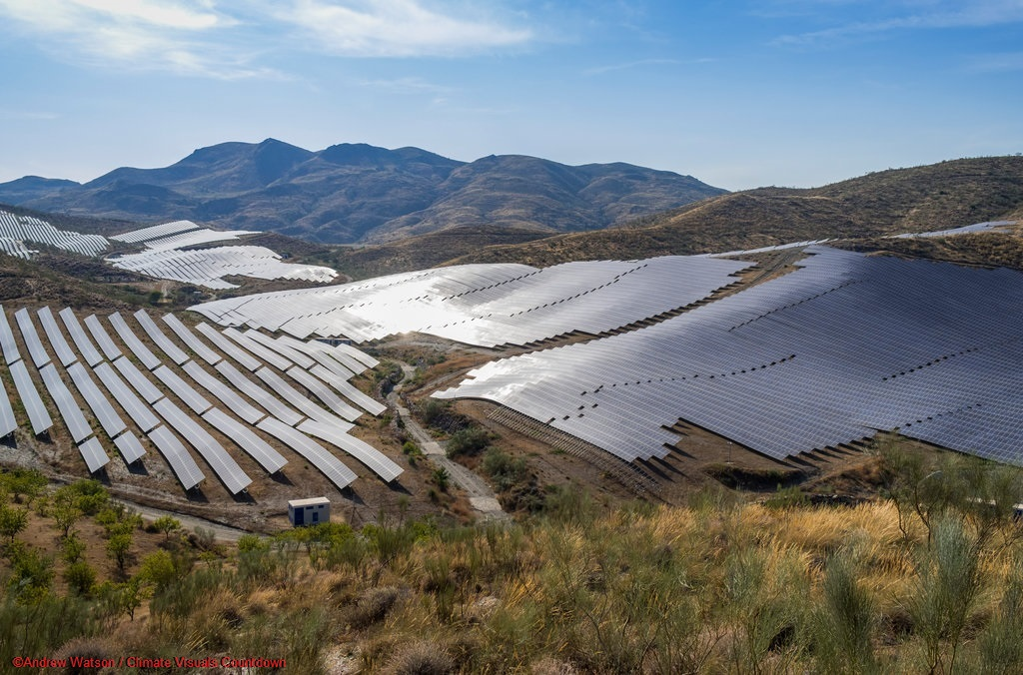
Gender-Responsiveness in adaptation planning and reporting
+ Q&A
Funanani Muremi
Adaptation Committee

Slide 16

Coffee break
Short break of 5 minutes. Please don’t leave this call but turn your camera off and mute yourself.
©GIZ/Création9

Slide 17

Interview
Minky Groenewald
Eswatini

Slide 18

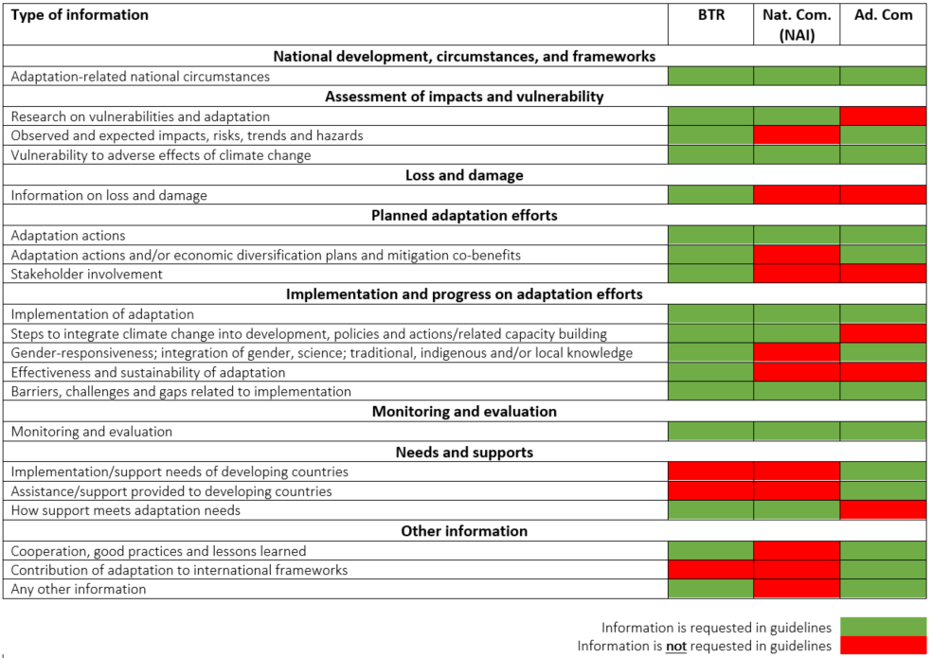
Exploiting synergies between the BTR and other UNFCCC reports
Streamlining adaptation reporting
The table visualises the overlap in the adaptation-relevant guidelines between the BTR, Nat Com and Ad Com.
Source: adapted from Adaptation Committee (2019)
Slide taken from the presentation “A closer look at adaptation reporting through the BTR” provided by Mr. Thomas W. Dale, UNEP DTU Partnership on day 1 (22.02.22) of the workshop

Slide 19

Communicating Adaptation Action in Eswatini: A stakeholder driven exercise
Minky groenewald
Ministry Of Tourism And Environmental Affairs

Slide 20
Table of contents
Background information
Stocktaking Assessment
Integration of climate change processes into the adaptation communication development process
Prioritization
Stakeholder engagement and coordination
Technical Working Sessions
Key lessons

Slide 21
Background information
The Government of Eswatini, Ministry of Tourism and Environmental Affairs (MTEA),
Support - the NAP Global Network to develop her first Adaptation Communication (AdCom).
Duration: June 2021- September 2021,
Submitted to the United Nations Framework Convention on Climate Change (UNFCCC) on 1 November 2021, in time for the COP26 summit.
National consultants

Slide 22
Initiating the process
Elaborating on the terms of reference
Ongoing national processes
Drawing lessons from the development of other national reports for submission to the UNFCCC i.e national communications and NDCs proved useful in ensuring that this exercise was done in a concise and targeted manner.
Stand-alone document vs Summary document
Design of the engagement process
Introspection (reflect weaknesses , highlight success stories and identify opportunities)

Slide 23
Stocktaking assessment
Review of key policy documents, strategies and other resources from international institutions.
The NAP Global Network resource library (Resource Library - NAP Global Network) and information on AdComs by the UNFCCC (Adaptation communications | UNFCCC)
Establishing the expected outputs of the AdCom made the stocktaking assessment for the relevant national policy documents and reports, country strategies and action plans, a guided exercise.

Slide 24
Integration of climate change processes into the adaptation communication development process
National Adaptation Plan Readiness Project
Nationally Determined Contributions Update
Fourth National Communication and Initial Biennial Update Report Project
GCF Readiness Project

Slide 25
Prioritization
Adaptation sectors
Alignment with the NDC Adaptation contributions
AdCom Annoted Outline
A preliminary assessment of the annotated outline was done against with available climate adaptation information to ensure that all subsections in the AdCom had adequate and concise information.

Slide 26
Stakeholder engagement and coordination
Stakeholder Mapping
The mapping of stakeholders was considerate effort guided by the Ministry and informed by the prioritized sectors to ensure that the representation of the key and influential stakeholders in the respective sectors was appropriate
Design of guidance tool for engagement
Prepared in advance based on the prioritized sector, asking the right questions
Resources e.g. GIZ Adaptation Communication Drafting Assistance Tool, the UNFCCC guidance of Vulnerability and Adaptation Assessment and Guidelines for National Adaptation Plans

Slide 27
Technical working sessions
Rigorous discussions on the annotated outline with the prioritized sectors in Eswatini.
Discussions were guided by these sectors, and their inputs were incorporated into the outline.
A major observation from the discussions was that measuring, reporting and verification (MRV) of adaptation actions was a big challenge as most MRV was focused on mitigation actions.
Flow of consultations

Slide 28
Key lessons
Stakeholder mapping and engagement - to guarantee that all consultations are informed by the relevant national experts and ownership of the development process is improved
Tracking and monitoring Adaption Action - to have a clear understanding of all adaptation action that is implemented in the country for accurate reporting, understanding barriers and to facilitate peer-learning.
Knowledge Management for adaptation – to ensure that Eswatini has an efficient adaptation knowledge management system inclusive of the generation, collection, handling and dissemination of adaptation information.
Public information Platforms – to ensure that adaptation information is publicly available such as access to current and detailed information on climate trends and adaptation interventions at all levels.

Slide 29
Key lessons
Design and development a robust programme for planning, identifying and communicating adaptation action in a way that is country specific and aligns with other national climate change processes.
Using the engagement process as a vehicle for stakeholders to come together and learn from one another.
https://napglobalnetwork.org/2022/02/adaptation-communication-lessons-eswatini/

Slide 30
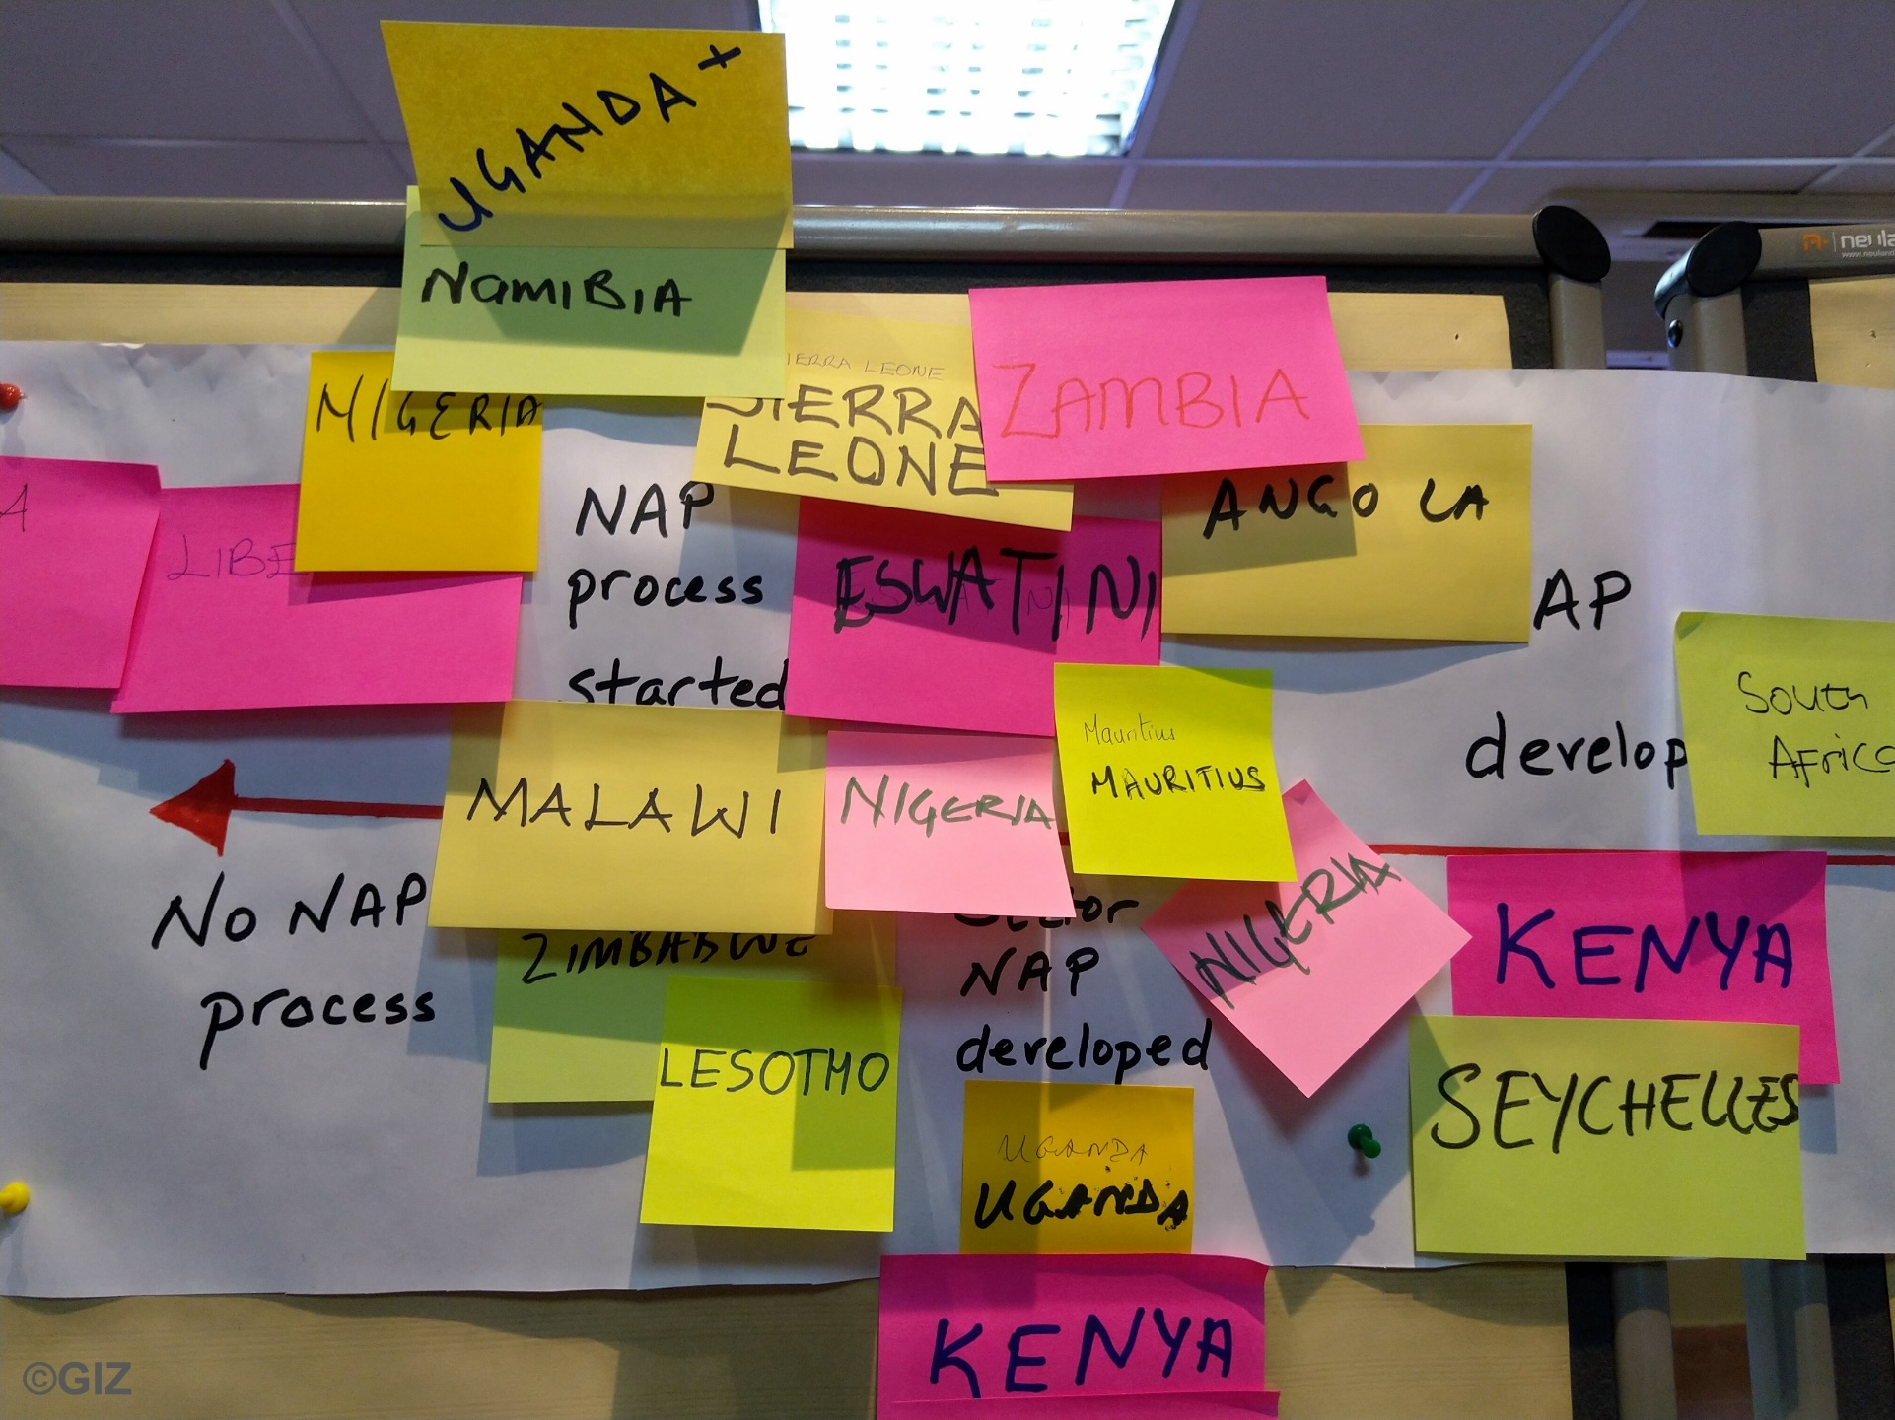
Break-out groups
Minky Groenewald, Eswatini
Reagan Chunga, Namibia

Slide 31

Adaptation-mitigation nexus
+ Q&A
Clémence Moinier
Ricardo E&E

Slide 32
Adaptation-mitigation nexus
23/02/2022

Slide 33
Provision of information in the BTR
I - National inventory report of anthropogenic emissions by sources and removals by
sinks of greenhouse gases
II - Mitigation
  National circumstances, institutional arrangements and legal frameworks
  Description of NDCs, including emission reduction target and scope
  Indicators to track progress
  Mitigation actions and their effect compared to the emission reduction target
  Summary of GHG emissions and removals
  Projections of GHG emissions and removal
III - Adaptation
  National circumstances, institutional arrangements and legal frameworks
  Impacts, risks and vulnerabilities
  Adaptation priorities and barriers
  Adaptation actions/plans/strategies
  Implementation progress
  M&E: Effect/outcome of adaptation actions implemented on impacts
  Loss and damage
  Cooperation and good practice
Mitigation co-benefits of adaptation actions
IV & V - Financial, technology development and transfer and capacity-building (provided and mobilised; needed and received)
Type of support received (cross-cutting, risk of double counting?)
VI – Research and systematic observation; education, training and public awareness
Linkages as in the Modalities, procedures and guidelines for the transparency framework for action and support referred to in Article 13 of the Paris Agreement

Slide 34
Provision of information in the BTR
I - National inventory report of anthropogenic emissions by sources and removals by
sinks of greenhouse gases
II - Mitigation
  National circumstances, institutional arrangements and legal frameworks
  Description of NDCs, including emission reduction target and scope
  Indicators to track progress
  Mitigation actions and their effect compared to the emission reduction target
  Summary of GHG emissions and removals
  Projections of GHG emissions and removal
III - Adaptation
  National circumstances, institutional arrangements and legal frameworks
  Impacts, risks and vulnerabilities
  Adaptation priorities and barriers
  Adaptation actions/plans/strategies
  Implementation progress
  M&E: Effect/outcome of adaptation actions implemented on impacts
  Loss and damage
  Cooperation and good practice
Mitigation co-benefits of adaptation actions
Adaptation co-benefits of mitigation actions
IV & V - Financial, technology development and transfer and capacity-building (provided and mobilised; needed and received)
Type of support received (cross-cutting, risk of double counting?)
VI – Research and systematic observation; education, training and public awareness
Further linkages beyond the Modalities, procedures and guidelines for the transparency framework for action and support referred to in Article 13 of the Paris Agreement
Linkages as in the Modalities, procedures and guidelines for the transparency framework for action and support referred to in Article 13 of the Paris Agreement

Slide 35
How co-benefits translate at reporting stages
Adaptation action
Emissions reduction
Emissions increases
Report under
II- Policies and measures, actions and plans
II - Effect compared to target
Implications on
II- Information to track progress
II - Projections of GHG emissions and removal
Targets
Indicators
II- Define methodologies used to estimate mitigation co-benefits of adaptation
II- Define methodologies used to estimate mitigation co-benefits of adaptation
Further linkages beyond the Modalities, procedures and guidelines for the transparency framework for action and support referred to in Article 13 of the Paris Agreement
Linkages as in the Modalities, procedures and guidelines for the transparency framework for action and support referred to in Article 13 of the Paris Agreement

Slide 36
How co-benefits translate at reporting stages
Mitigation action
Reduces vulnerability & risks
Increases vulnerability & risks
Implications on
III - Adaptation actions/plans/strategies
III – Vulnerability and risk assessment
Implications on
III - Implementation progress
III – Adaptation priorities and barriers
III - M&E - Effect/outcome of adaptation actions implemented on impacts
III – Implementation progress
Further linkages beyond the Modalities, procedures and guidelines for the transparency framework for action and support referred to in Article 13 of the Paris Agreement
Linkages as in the Modalities, procedures and guidelines for the transparency framework for action and support referred to in Article 13 of the Paris Agreement

Slide 37
Taking advantage of co-benefits and avoiding negative trade-offs when planning
Beware of thinking in terms of “traditional” mitigation sectors and “traditional” adaptation sectors
Identify co-benefits and trade-offs of actions at planning stage
  Remove or review action
  Develop new conditional action(s) to manage trade-off
  Replace with new win-win actions to avoid trade-off
  Accept trade-off (“adaptation-first” countries)
Align timelines for planning mitigation and adaptation actions
  Develop vulnerability and risk assessment first
  Project emissions considering adaptation actions
Coordinate between mitigation and adaptation stakeholders’
Build sectoral stakeholders’ capacity building on adaptation-mitigation nexus

Slide 38

Evaluation & Feedback
Was today’s session (Day 2) useful to you?
Strongly Agree (5) | Agree (4) | Neutral (3) | Disagree (2) | Strongly Disagree (1)
©Pixabay/Pexels​

Slide 39

Wrap up and the way forward
Clémence Moinier
Ricardo E&E

Slide 40

Contact
Partnership on Transparency in the Paris Agreement (PATPA)
Catarina Tarpo
catarina.tarpo@giz.de
The workshop report and the presentations will be available under News (transparency-partnership.net)

Slide 41






With the financial support of
This workshop was realized with technical contributions of
Adaptation Division,
UNFCCC secretariat
We would like to thank all country speakers for their valuable contributions

