Slide 1
TLOU RAMARU Chief Director: Climate Change Adaptation
South Africa’s Monitoring, evaluation and reporting for adaptation

Slide 2
Where is South Africa in the planning and reporting process at the moment and which document does it use to report progress?
- South Africa chose to communicate the adaptation communication through the NDC ;
- South Africa will continue to include the adaptation component of reporting into national communication;
Why has it chosen to use this vehicle for reporting?
- The vehicle offers flexibility for South Africa to cover amongst other elements;
- Trends and Climate Projections;
- Risk and vulnerability & impact assessments of key socio-economic sectors
- Analysis of adaptation options
What challenges have you encountered in this process and how did you overcome them?
- collection of data across various stakeholders
- SA developed the NCCIS to enable the collection and collation of the data and information for reporting purposes.

Slide 3
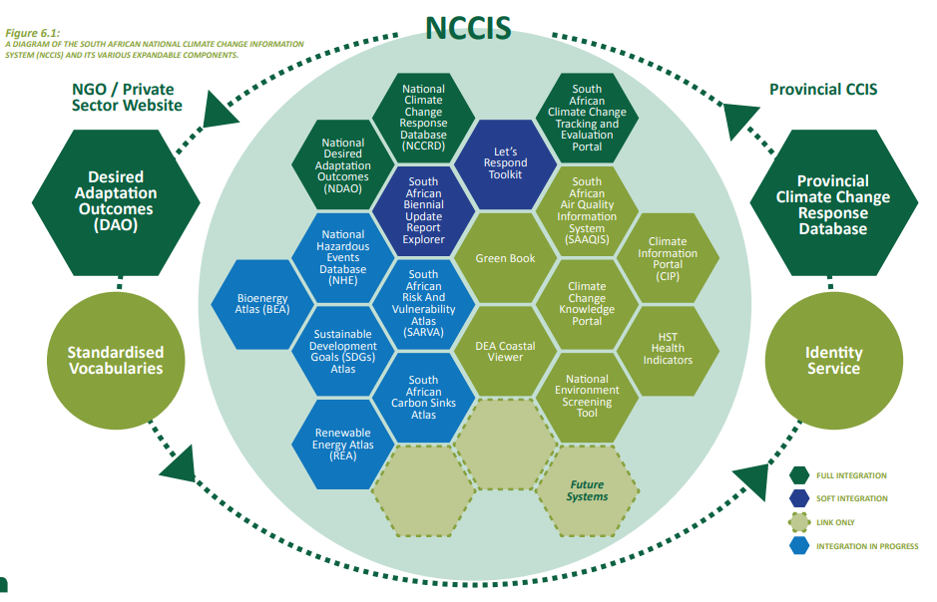
Notes:
• National Climate Change Response Database: a portal for capturing and reporting climate change projects and their details. • National Desired Adaptation Outcomes: designed as a monitoring and evaluation framework for climate change resilience through progress towards a series of adaptation goals. • Climate Information Centre: a collection of actionable data sets and information relevant to the South African climate change field, distributed as required by data providers and formal sources. • Tracking & Evaluation (T&E) Portal: a system which stores the data and information on the details of actions, indicators, impacts and related challenges, targets, and investments in climate change. This system also provides data visualisation, and provides outputs in formats required by the BUR. It will, therefore, assist the DFFE in producing BURs timeously. • Portfolio of online Atlases, decision support systems and tools. • Services, tools, static content, documentation including reports, policies and guidelines, and other digital objects developed by external partners and stakeholders. • Standardised vocabularies serving as a common frame of reference for climate change reporting and monitoring. • Search and discovery capabilities.

